Slide 1
Creating a Successful
Wellness Committee

Slide 2
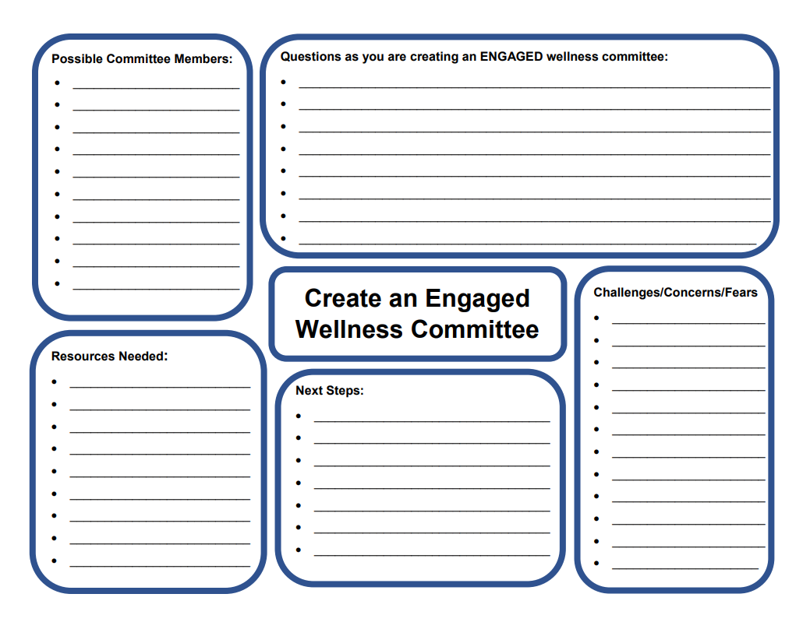

Slide 3
The Goal: Creating a Successful Wellness Committee
What the goal is:
Creating the foundation for a successful wellness committee
What the goal is NOT:
Solving the problem(s)
Coming up with solutions
Brainstorming creative ideas to implement

Slide 4
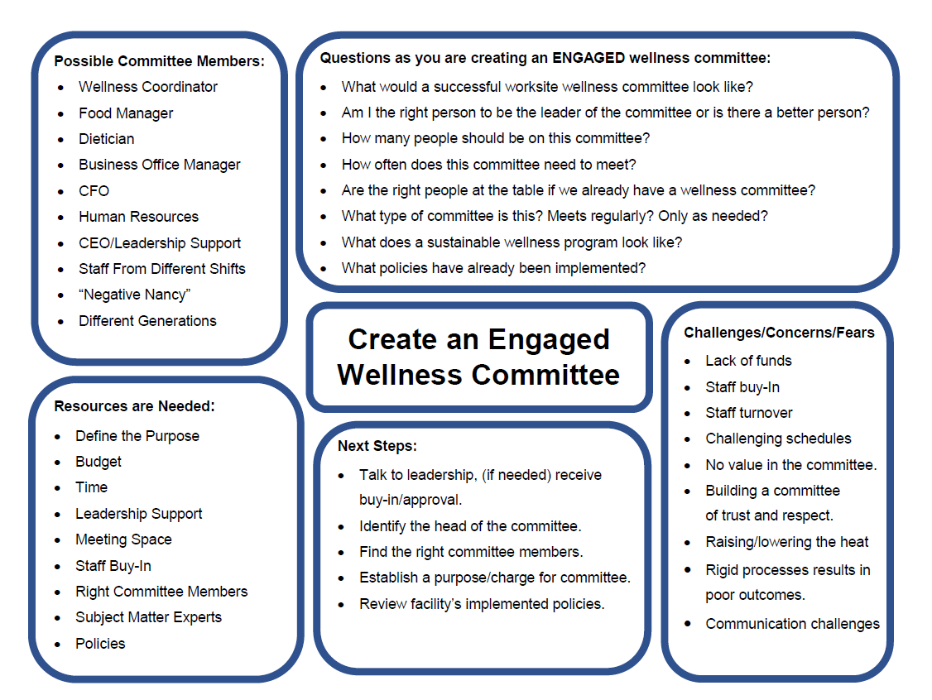
Committee Members
Brainstorm 10 – 15 People
“Rent the List”, Not a Concrete List
Identify Real People (Names)
Do seek people out. Don’t just ask for volunteers.
Identify Departments or Roles
**if You Cannot Identify the RIGHT Person
Make Sure Committee Represents your Hospital
  Departments
  Senior Leadership, Department Heads, Managers
  The “average Joe”
  Different Shifts
  Gender
  Different Generations
  Personality Types
Notes:
Is this just another department head/manager meeting?

Slide 5

Resources Needed
Make this an all encompassing list.
  What resources do you already have?
  What resources are needed?
Put an * by resources that maybe a challenge.
Do you need the “why” to have a committee?
Clear Committee Charge:
Increasing Employee Engagement vs. Engaging Employees in Wellness Activities?

Slide 6
Questions to Ask
"There are naïve questions,
tedious questions, ill-phrased questions,
questions put after inadequate self-criticism.
But every question is a cry to
understand the world. There is no such
thing as a dumb question".
– Carl Sagan
Dream for a second…
What are the tough questions that should be asked?
What questions could help you raise the heat (make change, movement, etc.) a bit?
If you are thinking of a question, most likely someone is too.

Slide 7
Challenges/Concerns/Fears
“Rent the List”, Not a Concrete List
How to use these Challenges/Concerns/Fears:
These are things that may become goals
Barriers the committee has to overcome for success?
Realizations of who needs to be on the committee?
Items to work out before first committee meeting?
Matters to talk about with senior leadership?
Experiment with challenges/concerns/fears

Slide 8
Next Steps
What are actionable next steps for your facility?
What are some short term next steps/goals for creating an ENGAGED wellness committee?
Think about: What are 3-5 easy wins, “Low Hanging Fruit”
  Could be implemented tomorrow, no/low risk
Think about: What is 1 or more challenging wins?
  Implemented over the next 6 months to a year

Slide 10
Tips/Tricks and Best Practices of a Wellness Committee
Meet monthly while committee is getting established
Survey committee about time/day of the week for meetings
Take minutes at the committee meeting
Have an agenda for each committee meeting
Invite in outside speakers for committee meetings
Experiment with wellness goals/projects. Then evaluate success, improvements, etc.
What else…..

Slide 11
Questions…
Contact Information
Hayley Finch-Genschorck
Director of Education
Kansas Hospital Association
(785) 233-7436
hfinch@kha-net.org

