Slide 1
Re-energizing KanCare Expansion
February 2022
Julie Bataille, GMMB

Slide 2
Agenda
Research Findings
Message Recommendations
Key Messengers
Discussion

Slide 3
Methodology
Focus Groups
Survey
PerryUndem and GMMB conducted three focus groups in November 2021 to understand current attitudes toward KanCare expansion and to gain insight into messages.
Two of the focus groups were held with Kansas voters who are white, lean more conservative politically, and who are conflicted about expanding the KanCare program. The focus groups included a few small business owners, individuals who are currently uninsured, and individuals from both rural and urban parts of the state.
The other focus group was conducted with advocates in Kansas who work on social issues, including improving access to health care and KanCare expansion.
The non-partisan research firm PerryUndem developed the survey. Chris Matthews of Bellwether Research (a Republican polling organization) consulted on this study.
The 15-minute survey was conducted by telephone (80% cell and 20% landline) December 20 – December 30, 2021, using Braun Research, Inc.
The survey included 613 Kansas registered voters 18 and older. The margin of sampling error for total results: + 3.96 percentage points.

Slide 4
Focus Group Findings

Slide 5


FOCUS GROUP FINDINGS - CURRENT ATMOSPHERE
They are struggling. These Kansans are struggling with rising costs (food, gas) and feeling a lot of financial pressure currently. Some are still recovering financially from the pandemic. Some feel there has not been enough help for families like theirs.
Health care is important but not top of mind. The state food tax, mask mandates/government intervention, and education are top issues. Health and health coverage do not come up immediately, but still are important.
Many feel the government has intervened too much. Some of these conflicted voters are frustrated with government (state and federal) and feel they have been too involved in their lives during the pandemic. They want them to back off. They want life to be normal again.
The people who are really struggling have been working all the way through (the pandemic). I’m not getting help.
Grocery shopping is so expensive right now… so is gas.
5

Slide 6
FOCUS GROUP FINDINGS - CURRENT ATMOSPHERE
There is agreement that health care and coverage are too expensive. Many feel they pay high costs and are not getting much in return. Some have high deductible plans that require them to pay a lot out of pocket. Many are trying not to use their insurance to avoid high costs.
Those who are uninsured are worried. They put off health care and are afraid of getting sick, needing to go to the hospital and receiving large bills. Those with insurance have empathy – they understand how someone could not be offered insurance through a job or be unable to afford it.
Many have medical debt. About half in each focus group have medical debt and it can be into the thousands of dollars. It is affecting their credit and their ability to be financially stable. This is a shared experience among Kansans that we might want to tap in messaging.
You don’t want to think about the times of not having insurance.
It’s horrible not to have health insurance…it’s scary because I’m an older woman.
6

Slide 7
FOCUS GROUP FINDINGS - COMMUNITY
They feel Kansas is a good place to live. They are proud of their state. Many mention the low cost of living. Some see their downtowns thriving and expanding. Many feel there are supports, programs, and organizations (mostly local, non-governmental) for families who need help. They also speak about Kansans’ values – neighbors helping neighbors, strong communities.
But they are aware of a perception of Kansas being behind. They feel outsiders see the state as less progressive and perhaps less developed. Some perceive businesses choose their neighboring states to establish their roots for these reasons but others refute that, see new businesses coming into their communities.
They feel there are plenty of jobs. But they don’t feel a lot of people in the state want to work. Some blame generous unemployment benefits as a reason people are not working.
Some people feel like Kansas is behind…infrastructure is one area. And people might tend to believe we’re not as highly-educated or the infrastructure isn’t great.
I think there are enough people (for the jobs available), but not enough people who want to work or want to change career fields.
Unemployment benefits are high, better than these jobs.
7

Slide 8
FOCUS GROUP FINDINGS - KANCARE
Many have positive experiences. Those with children covered by the program or had it when pregnant have positive things to say about KanCare. But, at the same time, they are frustrated that they could not have KanCare coverage for themselves.
Some of those without personal experience tend to have favorable views of the program. This is especially true when it comes to care during pregnancy or covering children. Many appreciate the role KanCare plays in their state. Hardly any have negative impressions, with one or two just pointing out it is “government insurance.”
None knew about the strict income requirements. When told the income limit for a family of three to qualify for KanCare is less than $8,345 a year, all say this is too low. It is a key point of information for these voters – many become more favorable to expansion after hearing this. One figured out this was only $4.00 an hour and was appalled.
I had it when I had children…but it was clear I could only use it for things related to the child, but not for me.
My son was covered by KanCare. It was a really good insurance… my son was able to get physicals, dental, and I never had to pay out-of-pocket.
That is an absolute ridiculous amount of money for a family of three (to qualify for KanCare), that’s ridiculous, no one can afford (to live off) that!
8

Slide 9
FOCUS GROUP FINDINGS - EXPANSION MAP
They were surprised by the map. They had no idea Kansas was one of the last states not to expand their Medicaid program.
The image made Kansas appear isolated. They noticed the surrounding states had expanded and Kansas stood alone.
They mention that the remaining non-expansion states are Republican-led. It makes them think that opposition to expansion must be ideological. Also, a few notice it is mainly “Bible Belt” states that have rejected expansion – which raises moral questions about expansion for a few.
The result of the map – why hasn’t Kansas expanded? This is the question most ask after seeing the map. It makes no sense to them if so many other states – including their neighbors – have already expanded. “I want to know why?”
9

Slide 10
Survey Findings

Slide 11

Survey Summary
The statewide survey found that…
01 | Almost 8 in 10 Kansas voters (78%) support the state expanding KanCare (Medicaid) so that more low-wage Kansans can qualify for health coverage. Key to this support is learning about the state’s strict eligibility limits for the program and that an uninsured parent in a family of three has to earn less than $4.00 an hour to qualify.
02 | Support for expanding KanCare is broad and spans political parties (Dem 96%, Ind 76%, Rep 65%) and geography across Kansas (urban 85%, suburban 79%, small town 76%, rural 73%). Women are especially concerned about the cost of health care these days and are among the most supportive of expanding KanCare (87% support expansion).
03 | Kansas voters want accountability. Most (81%) want their elected officials to vote to expand KanCare and if they don’t, 84% feel these officials should have to publicly explain their refusal. There is clear, bipartisan direction for elected officials on this issue.
04 | Voters are more likely to support expanding KanCare when they learn that 165,000 low-wage Kansans could immediately gain health coverage (75% more likely to support expansion), that the federal government would pay more than 90% of the costs (74% more likely), and that all states bordering Kansas have already expanded their Medicaid programs (72% more likely).
11

Slide 12
Survey Summary
05 | One reason Kansas voters support KanCare expansion is they feel many in the state are feeling a financial pinch and could use the help. For example, 9 in 10 (89%) say they are concerned about rising food prices right now while 86% say they are concerned about health care costs. These cost concerns lead 82% of voters to agree that a good reason to expand KanCare is to help low-wage Kansans who are feeling financial pressures and have no other option for health coverage.
06 | Another reason to expand KanCare is to protect people from medical debt (i.e., large bills from hospitals, doctors, or other health providers), which is often related to a lack of health coverage. More than 4 in 10 Kansas voters (41%) say they currently have medical debt or have family members who have medical debt. This is likely why 82% agree that a reason to expand KanCare is to protect Kansas families from incurring medical debt during these difficult times.
07 | Finally, most Kansas voters want the issue of KanCare expansion to be settled. Most (84%) agree we need a long-term fix to KanCare so that more low-wage families can count on the program if needed.
12

Slide 13
More than 8 in 10 Kansas voters are concerned about the costs of health care right now.
TOTAL CONCERNED | 86%
Democrats | 90%
Independents | 84%
Republicans | 85%
People of Color* | 85%
White | 86%
Men | 83%
Women | 90%
18-34 | 89%
35-54 | 87%
55-64 | 91%
65+ | 80%
<$40K | 85%
$40K to $75K | 92%
$75K+ | 85%
Urban | 83%
Suburban | 88%
Small Town | 82%
Rural | 87%
Q: How concerned are you right now about… “the costs of health care?”
86%
Concerned
*Caution small sample size N=69.
13

Slide 14
8 in 10 voters do not think private health insurance is affordable to someone in Kansas who has to buy it on their own.
TOTAL UNAFFORDABLE | 83%
Democrats | 86%
Independents | 84%
Republicans | 80%
People of Color* | 72%
White | 84%
Men | 80%
Women | 86%
18-34 | 86%
35-54 | 80%
55-64 | 86%
65+ | 84%
<$40K | 82%
$40K to $75K | 86%
$75K+ | 84%
Urban | 83%
Suburban | 86%
Small Town | 82%
Rural | 83%
Q: Generally speaking, if someone in Kansas loses a job and has to buy insurance on their own, do you think that private health insurance is affordable or unaffordable?
83%
Unaffordable
*Caution small sample size N=69.
14

Slide 15
Nearly 8 in 10 voters support the state expanding KanCare (Medicaid) so more low-wage Kansans can get health coverage. Support is broad and spans political parties and geography.
TOTAL SUPPORT | 78%
Democrats | 96%
Independents | 76%
Republicans | 65%
People of Color* | 85%
White | 79%
Men | 68%
Women | 87%
18-34 | 81%
35-54 | 73%
55-64 | 80%
65+ | 78%
<$40K | 88%
$40K to $75K | 79%
$75K+ | 70%
Urban | 85%
Suburban | 79%
Small Town | 76%
Rural | 73%
Q: Do you support or oppose the state expanding KanCare so that more low-wage Kansans can get affordable health coverage?
Survey respondents heard the following:
“KanCare is a health insurance program mainly for low-income children, pregnant women, seniors, and people with disabilities. It covers doctor visits, hospitalizations, prescriptions, mental health care, and other basic services. In Kansas, there are strict limits on who can qualify. For example, an uninsured parent in a family of three has to earn less than $4.00 an hour to qualify. If you don’t have children, you cannot qualify at all, no matter how low your income is.”
78%
Support
*Caution small sample size N=69.
15

Slide 16
Kansas voters want accountability. Specifically, more than 8 in 10 voters agree that any Kansas politician who stands in the way of expanding KanCare should have to publicly explain their reasons for refusing to expand.
TOTAL AGREE | 84%
Democrats | 95%
Independents | 86%
Republicans | 74%
People of Color* | 90%
White | 84%
Men | 80%
Women | 88%
18-34 | 86%
35-54 | 81%
55-64 | 84%
65+ | 85%
<$40K | 91%
$40K to $75K | 87%
$75K+ | 79%
Urban | 93%
Suburban | 82%
Small Town | 81%
Rural | 83%
Q: Please tell me if you agree or disagree with the following statement: “Any Kansas politician who stands in the way of expanding KanCare should have to explain publicly why they are against it.”
84%
Agree
*Caution small sample size N=69.
16

Slide 17
In addition, 8 in 10 voters agree that a reason to expand KanCare is to protect Kansas families from medical debt (which 4 in 10 are actually dealing with right now).
TOTAL AGREE | 82%
Democrats | 94%
Independents | 78%
Republicans | 74%
People of Color* | 87%
White | 81%
Men | 74%
Women | 89%
18-34 | 84%
35-54 | 78%
55-64 | 77%
65+ | 85%
<$40K | 89%
$40K to $75K | 84%
$75K+ | 75%
Urban | 87%
Suburban | 81%
Small Town | 80%
Rural | 77%
Q: Now, I am going to read some reasons why the state should expand KanCare. After each one, please tell me if you agree or disagree with this reason: “A quarter of Kansas working-age adults and a third of the state’s children live in households dealing with medical debt. Expanding KanCare can financially protect families during these difficult times.”
82%
Agree
*Caution small sample size N=69.
17

Slide 18
Most voters want the issue of KanCare expansion to be settled. They want a long-term solution so that low-wage families in the state can count on the program being there if they need it.
TOTAL AGREE | 84%
Democrats | 97%
Independents | 82%
Republicans | 73%
People of Color* | 87%
White | 83%
Men | 76%
Women | 91%
18-34 | 85%
35-54 | 82%
55-64 | 81%
65+ | 86%
<$40K | 91%
$40K to $75K | 84%
$75K+ | 78%
Urban | 91%
Suburban | 81%
Small Town | 82%
Rural | 81%
Q: Please tell me if you agree or disagree with the following statement: “I want a long-term fix to KanCare so that more low-wage families can count on the program if they are not offered health insurance through a job or cannot afford to buy it on their own.”
84%
Agree
*Caution small sample size N=69.
18

Slide 19
Message Recommendations

Slide 20
Message Frame
Costs are rising and Kansans are paying more to take care of themselves and provide for their families. Healthcare is no exception. It’s time to help Kansans get more for their money when it comes to healthcare and bring good paying jobs to our state.
Expanding KanCare will reduce health care costs for everyone by providing health insurance to 150,0000 residents in rural areas, small towns, and cities across the state. Expanding KanCare will provide coverage to hardworking Kansans and result in much needed investments in our communities to strengthen our hospitals, clinics, and provider networks. It will also protect and bring in thousands of jobs, keeping us competitive for local businesses and a good place to live, work and raise a family.
Now is the time to invest in our state and ensure that Kansans have access to the care they need when they need it. Now is the time to expand KanCare or all of us will keep paying the price.

Slide 21
Key Messages
Reduce health care costs for everyone. Every Kansan is paying the price for not expanding KanCare. When low-wage Kansans can’t get health coverage that means more in ER bills, increased uncompensated care for hospitals, and untreated mental and physical health needs. This means individuals, families, and businesses all end up paying more for health care. Expanding KanCare will reduce costs for all Kansans.
Protect Kansans from medical debt. People all over the state feel the effects of rising costs for housing, food, and other needs, including health care. Almost half of Kansans have medical debt or know someone who does. By expanding KanCare, tens of thousands of people will be able to afford insurance coverage. That protects them from medical debt, so they can use those savings to pay for other essentials.
Fix-eligibility limits, which are currently too low. The income limit to qualify for KanCare is less than $8,345 a year for a family of three, which is less than $4 per hour. Expanding KanCare would raise the income eligibility limits so that more hardworking Kansans who contribute to the economy can get the health care they need for themselves and their families.

Slide 22
Key Messages
Preserve and strengthen rural healthcare. Kansans in our rural communities already have a hard time accessing health care when and where they need it, and rural health care providers face high levels of uncompensated care. In fact, 70 rural hospitals are currently at risk of closing across our state, more than other state our size. Expanding KanCare would strengthen and sustain the rural health care system and help ensure rural Kansans get the health care they need while giving a boost to their economies.
Make Kansas more economically competitive. Expanding KanCare would increase the state’s economic output by $17 billion and increase Kansas personal income by $6.3 billion over the next three years. Expanding KanCare will not only improve the health of Kansans, but it will also help our state to compete with our neighbors who have expanded eligibility for their Medicaid programs.

Slide 23
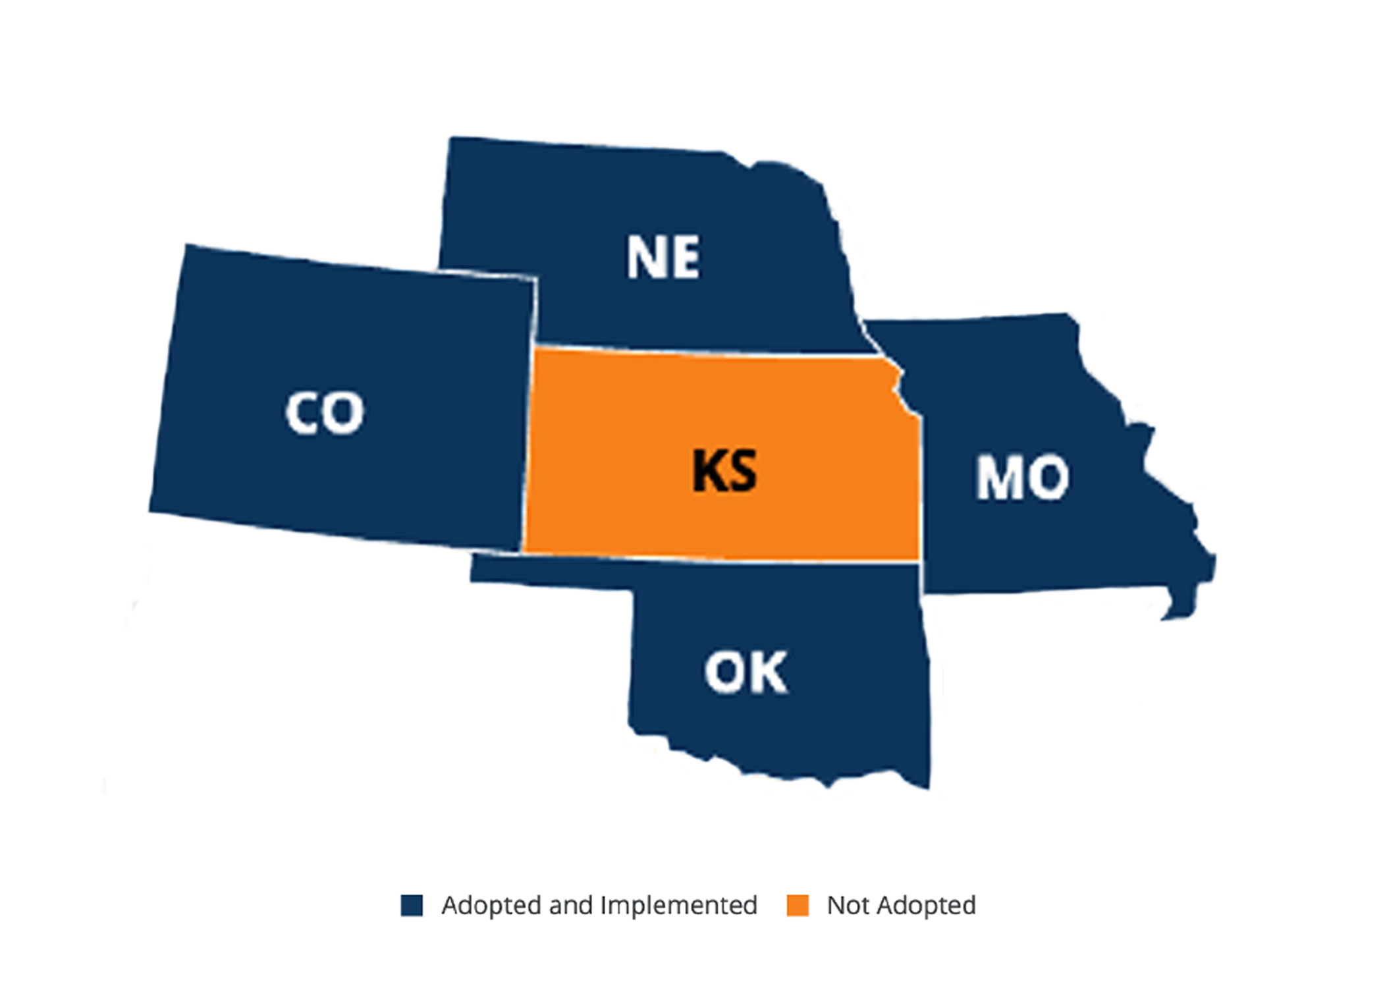
Messaging to Drive Accountability & Urgency
Many in Kansas do not realize that their state is one of the few remaining states to not expand and that all the states bordering Kansas have expanded. This leads them to question why Kansas has remained a holdout.
Research Insight:
  Kansas voters want accountability from their elected officials. If their elected officials don’t vote to expand KanCare, more than 8 out of 10 Kansas voters feel these officials should have to publicly explain their refusal.
  Voters were clear that they want a long-term solution for KanCare expansion.
Suggested Message: Now is the time for lawmakers to expand KanCare. We must stop putting politics over people. How are you going to make sure that our friends, neighbors, and workers making between $4-$14/hour can get the health care they need?

Slide 24
Key Messengers
Researchers at Kansas State University
Patient organizations such as the American Cancer Society of AARP
Doctors and nurses
Groups that represent children, such as the Kansas Action for Children
Groups that represent farmers, such as Kansas Famers Union

Slide 25
Thank You.
julie.bataille@gmmb.com

