Slide 1
Keep Kansas Dollars in Kansas
with a Kansas Solution:
The Bridge to a Healthy Kansas
Insert Meeting Name
Your Name
Date
Notes:
To insert your hospital logo or remove this logo place holder, click on View, click on Slide Master, and add logo or delete placeholder. Then click Close Master View.

Slide 2
Keeping Kansas Healthy and Economically Strong
Kansas hospitals are proud to provide care to our communities 24 hours a day, seven days a week, 365 days a year.
Every year, we serve thousands of individuals and keep our communities healthy, strong and vibrant.
Kansas hospitals believe Kansas should develop a unique, Kansas-based solution that takes advantage of the federal funds to build upon and improve our current KanCare program.

Slide 3
The Facts on Expansion
Expansion is voluntary. The U.S. Supreme Court ruled the federal government cannot force states to expand Medicaid. A state may elect to expand coverage and then later decide to discontinue.
The federal government will pay 100% of the cost of the newly eligible Medicaid population for the first three years (2014-2016). This percentage will be reduced until it reaches 90% in 2020, and it will remain at that level.

Slide 4
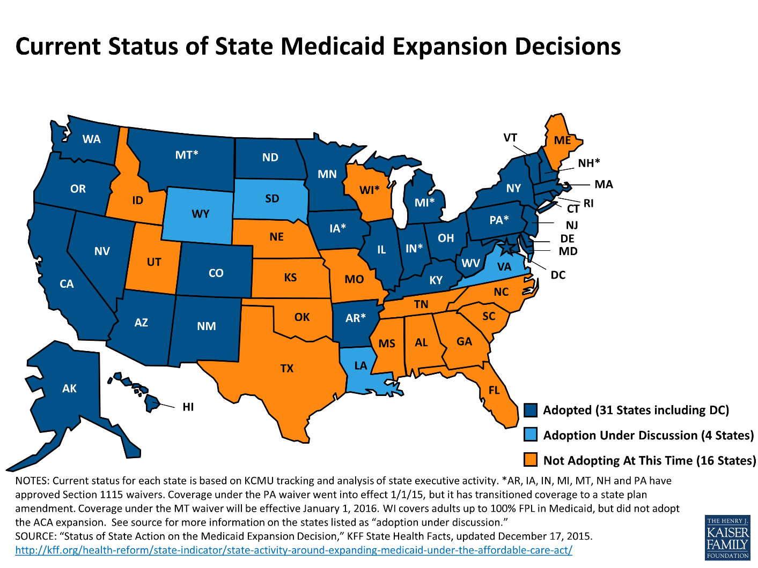
Across the Country

Slide 5
Kansas Medicaid = KanCare
KanCare is a managed care solution to slow the growth of Medicaid costs in Kansas by controlling costs and improving health outcomes.
  KanCare Vision: To serve Kansans in need with a transformed, fiscally sustainable Medicaid program that provides high-quality, holistic care and promotes personal responsibility.
Created by our current administration, expansion of KanCare will continue to provide the right care, in the right setting and at the right time.
Notes:
KanCare went into effect Jan. 1, 2013, and was originally estimated to save $1.0 billion over five years.

Slide 6
Path to Personal Responsibility
No Insurance
- No accountability or responsibility
- Endless access to ER
- No management of chronic conditions
- Cost of care shifted to Private Insurance
KanCare
-“Skin in the Game” Component to create more responsible consumers
- Access to primary care and management of chronic conditions
- Co-pays and premiums to help cover cost
Private Insurance
- Responsible for selecting and purchasing private health care services
- Able to access right care at the right time
- Cost of care borne by the beneficiary

Slide 7
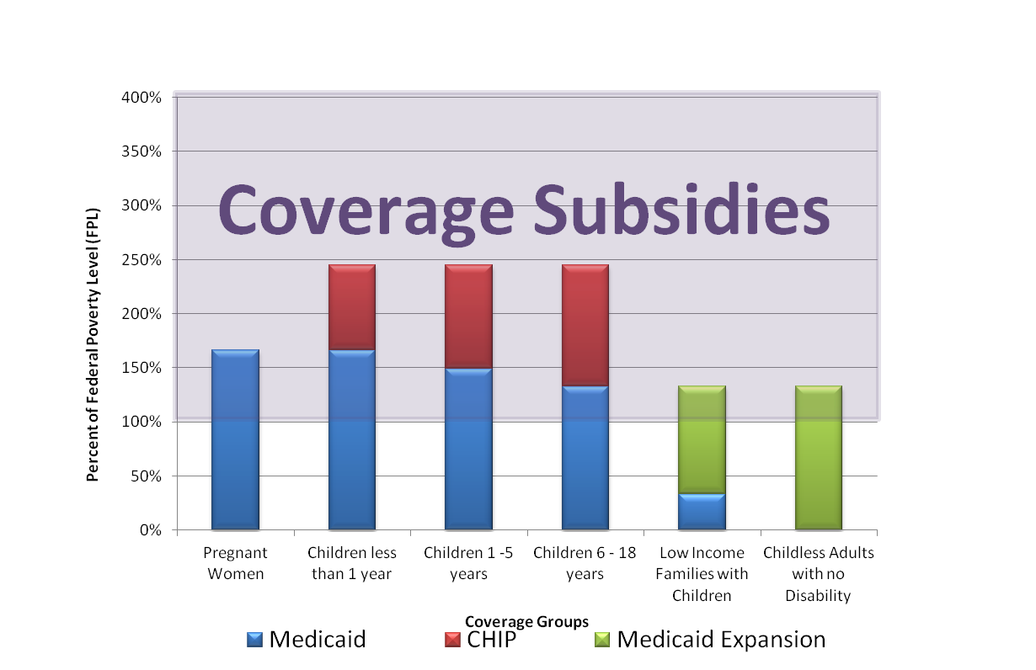
Eligible Kansans
138% FPL
Approximately 78K People
Source: Kansas Hospital Association
Notes:
The chart represents three things – current Medicaid and CHIP eligibility, as well as expansion eligibility and health insurance subsidies.
The red and blue columns on the chart represent current eligibility for both Medicaid and CHIP – the categories are listed along the bottom. The green bars represent the Medicaid expansion population.
The gray area represents the incomes that are eligible for subsidies – 100% to 400% of the federal poverty level.
The orange line represents the Medicaid expansion level to 138% of poverty (if you add in the income set aside) – so, parents between 30 and 138 percent of poverty and single, non-disabled adults up to 138% of poverty would be the newly eligible group.
The black box is there to identify the group who will have no coverage and no subsidies if Medicaid is not expanded.

Slide 8
Who Are They?
Approximately 150,000 Kansans would become eligible for coverage if KanCare is expanded.
The income at 138 percent of the Federal Poverty Level for a family of three is $27,310 a year or $2,276 a month.
The majority of Kansans who would be eligible under KanCare expansion work as dishwashers, housekeepers, health care support workers, janitors, nursing assistants, landscapers, bus drivers, child care workers, medical assistants, retail sales people and fast food workers in Kansas communities.
78,000 Kansans fall into the coverage gap – they don’t qualify under the current KanCare program and are too poor to qualify for subsidies in the Health Insurance Marketplace.
Notes:
Illegal immigrants are NOT eligible if Medicaid is expanded in Kansas.

Slide 9
Work Status of the
Newly Eligible Population
Notes:
Employed Group Statistics:
46.8% worked 50-52 weeks in the last 12 months
Where do they work
Cooks
Cashiers
Sales workers/truck drivers
Waiters and Waitresses
Nursing, Psychiatic and Home Health Aids
Construction
Janitors
Retail Sales
Maids and Housekeeping
Freight, Stock and Material Movers
Unemployed Group Statistics:
26.4% had less than a high school diploma/GED
18.8% are women with children
15.0% have a disability
Not in the Labor Force Group Statistics:
14.8% Enrolled in School
31.8% have less than a high school diploma/GED
30.5% are women with children
18.6% have a disability

Slide 10
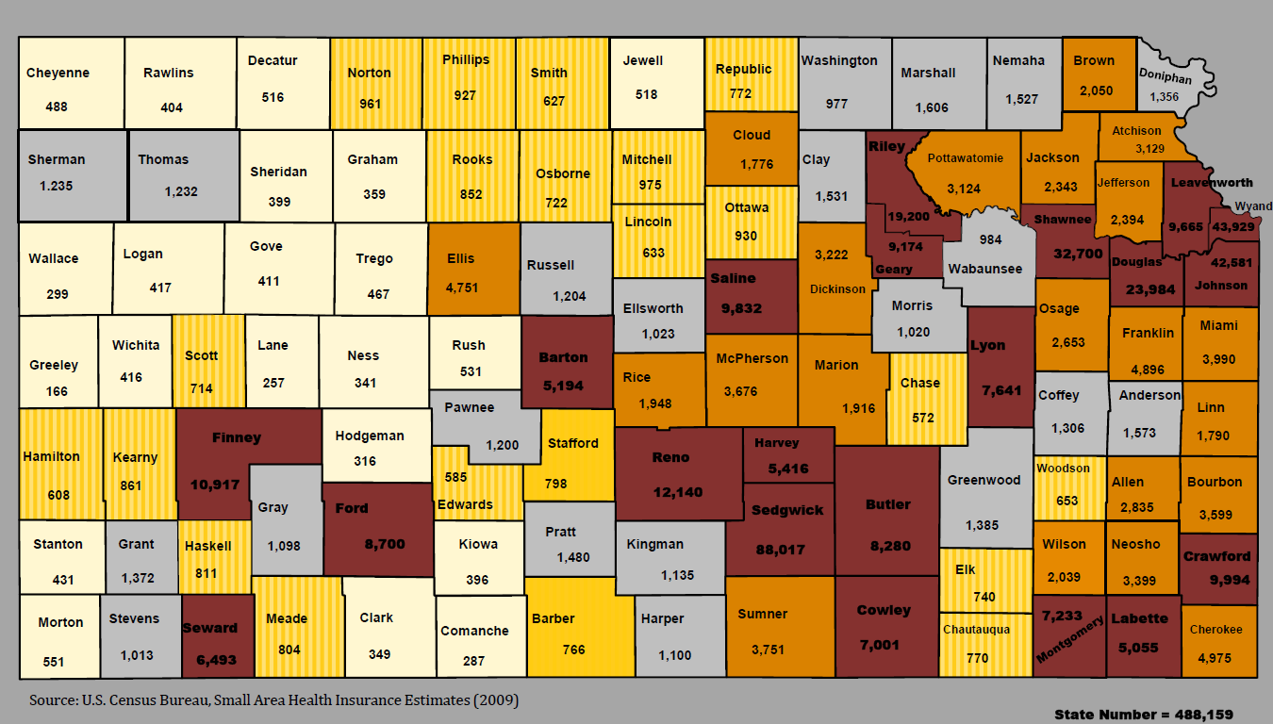
Numbers of Kansans Under Age 65
Earning Incomes at or Below 138% FPL

Slide 11
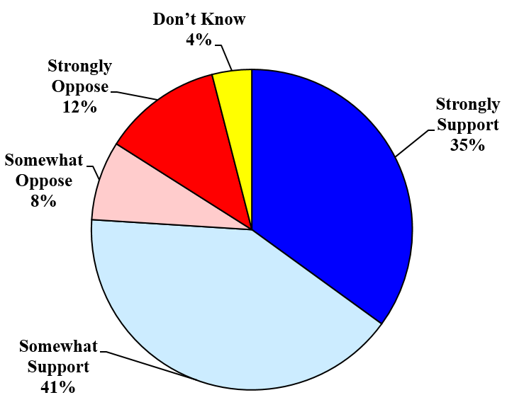
Kansans overwhelmingly support a
budget-neutral program within KanCare
Total Support: 76%
Total Oppose: 20%
Public Opinion Strategies
Kansas Statewide Survey – February 18-21, 2016
Notes:
Key findings from a statewide survey of 500 likely voters in Kansas, conducted February 18-21, 2016 by Public Opinion Strategies. Margin of error of +4.38%.
“In January 2016, the Kansas Legislature was presented with new legislation that proposes a new, budget-neutral program – a bridge within the current KanCare program that would make health care coverage accessible for approximately one hundred fifty thousand Kansans who do not earn enough to afford private insurance today. This program has eligibility requirements. Participants must be legal residents or U.S. citizens and full-time residents of the state of Kansas. Participants must work twenty or more hours per week; those who do not work at least twenty hours a week must be involved in work training, or they must be a student or stay-at-home parent to be eligible. Participants must demonstrate personal responsibility by paying a portion of the cost of their health care. Knowing this, do you support or oppose this program that expands KanCare?”

Slide 12
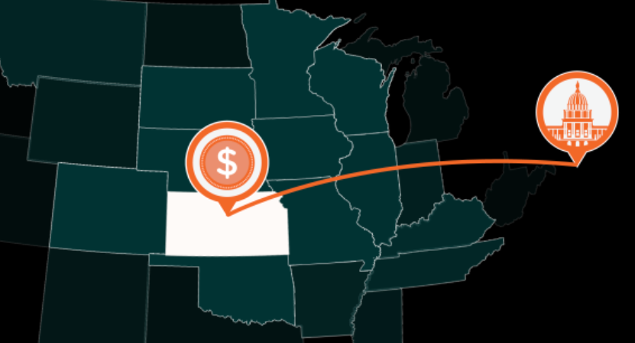
Whether Kansas expands KanCare or not, Kansas dollars are going to the federal government …
Since January 2014, more than a billion dollars in federal reimbursement cuts, additional fees and taxes intended to support the Affordable Care Act has left Kansas and is going to the federal government …
Notes:
More than a billion dollars (hit a billion on February 21, 2016) in federal reimbursement cuts, additional fees and taxes intended to support the Affordable Care Act has left Kansas is going to the federal government to be spent in other states – states expanding their Medicaid programs.

Slide 13
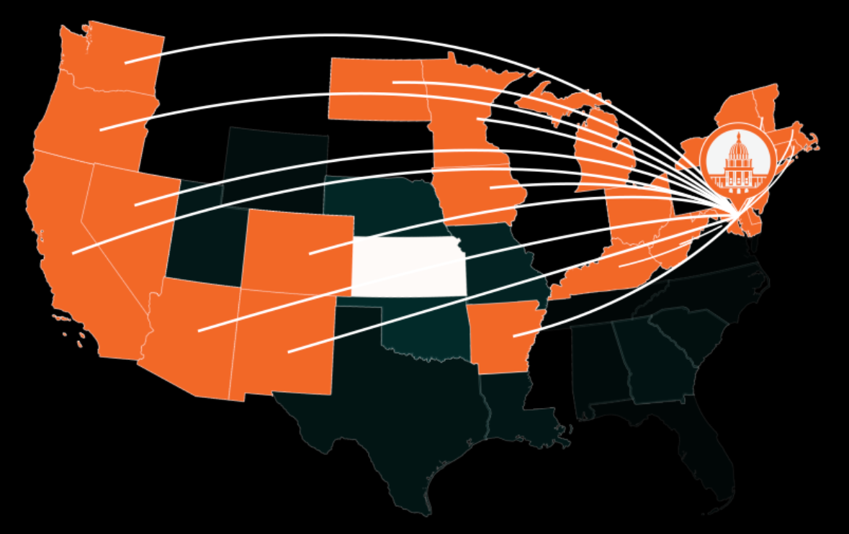
… to support expansion in other states.
Kansans are financially supporting expansion, just not in Kansas.
Notes:
The Kansas Hospital Association maintains a live ticker of this growing number that demonstrates what inaction on KanCare has cost Kansas (go to: www.kha-net.org. ). That money should not go to other states.
Bring Kansas money back to Kansans by Expanding KanCare.

Slide 14

Do Not Leave Money on the Table
The Kansas Department of Health and Environment estimates that if KanCare were expanded in 2016, expansion would bring $2.4 billion in federal dollars to Kansas over the next three years (2016-2018) to care for the most vulnerable Kansans.
Notes:
The Kansas Department of Health and Environment estimates that if KanCare were expanded in 2016, expansion will bring $2.4 billion in federal dollars to Kansas over the next three years (2016-2018) to care for the most vulnerable Kansans.

Slide 15
Impact Expanding KanCare has on Kansas’ Hospitals
Hospital Type | # of Hospitals | Avg. 2016 Impact per Hospital, per Year | Avg. Annual 10-year Impact per Hospital, per Year
Critical Access Hospital (CAH) | 84 | $255,469 | $370,255
Rural, Non-CAH | 16 | $913,418 | $1,323,828
Urban | 28 | $6,255,445 | $9,256,302
The proportion of KanCare expansion funding closely
resembles the state’s population and service areas.
Notes:
Cash flow is a large concern for rural hospitals
The proportion of Medicaid expansion funding closely resembles the state’s population and service areas.
What should be cogitated is the effect the increased funding has on rural hospitals. It should be noted that, on average, the annual 10-year average impact of expansion for a Critical Access Hospital is $370,255. This is a significant amount of money relative to the size of those CAHs.
Further – studies have indicated that hospitals in expansion states have seen uncompensated care decrease by nearly 1/3rd
If you take KDHEs data that highlights the benefit of expansion and divide it by the population:
Wichita - $110 per person
Hays - $153 per person
Chanute - $196 per person
Ulysses - $108 per person
Abilene - $74 per person
Kingman - $89 per person (pop. 3200)
On the contrary…
ALL hospitals, from the smallest Critical Access Hospital to the largest tertiary care center, help to form the safety net that protects vulnerable Kansas citizens.
ALL hospitals, no matter what size, serve as economic anchors for their communities, providing excellent employment opportunities and improving the quality of life.
ALL hospitals, regardless of the number of beds, serve as a valuable community resource. So to propose that one group of hospitals gets left out of the benefits of expansion is not only wrong, it suggests a lack of understanding regarding the strong interdependencies among Kansas hospitals.

Slide 16
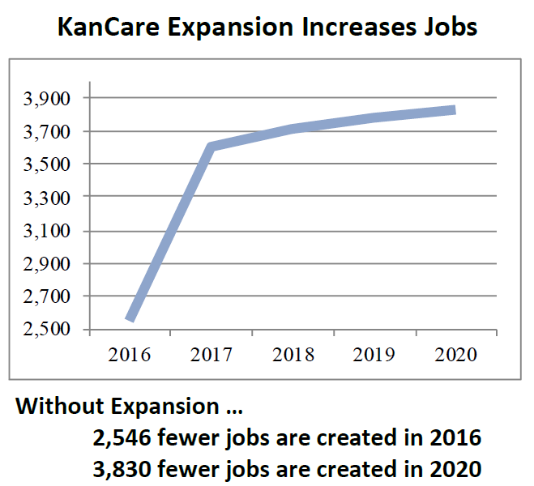
Employment Impact
KanCare Expansion will add needed dollars to the Kansas economy that will assist in growing the economy, creating jobs and supporting the state’s budget through increased revenues and cost savings.
Without KanCare
Expansion, roughly
2,546 fewer jobs
across all industries
will be created in 2016;
this rises to 3,830
fewer jobs in 2020.
Source: Economic and Employment Effects of Expanding KanCare in Kansas, authored by researchers at Regional Economic Models, Inc. and George Washington University, Nov. 2014.

Slide 17
The Bridge to a Healthy Kansas includes:
  Personal Responsibility
  Limitation to US Citizens and Legal Residents
  Requirement of Kansas Residency
  Employment as Part of the Solution
  Support for Kansas Employers by Supporting Employment and Employer Sponsored Insurance
  Focus on Preventive Care
  Access to ALL Federal Dollars
  State Portion from Beneficiary Contributions, Cost Savings and New Revenue Generated by the Newly Eligible
  Withdrawal Option if the Federal Match Goes Below the 90% Level Promised by the ACA

Slide 18
Financing Expansion in Kansas
$178.0 Million
$159.4 Million
$114.5 Million
$57.5 Million

Slide 19
A unique, new Kansas solution.
A budget-neutral program.
Provides a path to health and personal responsibility.
The Bridge to a Healthy Kansas

Slide 20
For More Information
Together we can build
The Bridge to a Healthy Kansas
Insert your Name
Hospital
Contact Information

