Slide 1

The Importance of the Health Care Sector to the Kansas Economy
Findings from the 2026 Analysis
Institute for Policy & Social Research
University of Kansas

Slide 2

Significant Economic Contributions of the Health Care Sector in Kansas
Creating direct jobs and income
Creating secondary jobs and income
Creating direct tax revenue
Creating secondary taxes
Notes:
The economic impacts of the health care sector permeate the entire Kansas economy, through job and income creation, tax generation, and quality of life enhancements. Specific channels of influence include:
Creating direct jobs and income within the health care sector when health care establishments hire staff;
Creating secondary jobs and income when suppliers to health care industries hire their own employees and when employees purchase goods and services such as groceries in the community;
Creating direct tax revenue when health care establishments pay income taxes on profits and property taxes on buildings and land;
Creating secondary taxes when employees pay income taxes, pay sales taxes on their purchases and pay property taxes on residences and vehicles;
This presentation focuses on the first four financial roles of the health care sector and briefly reviews the literature on additional roles of health care in improving the business climate and the quality of life in the state.

Slide 3
Health Care Employment as a Share of the Kansas Economy
Notes:
Health care is one of the largest components of the Kansas economy, it’s size exceeded only by government work and the broader services sector.
In 2024, more than one in ten Kansas workers (11.0 percent) was employed in the health care sector

Slide 4
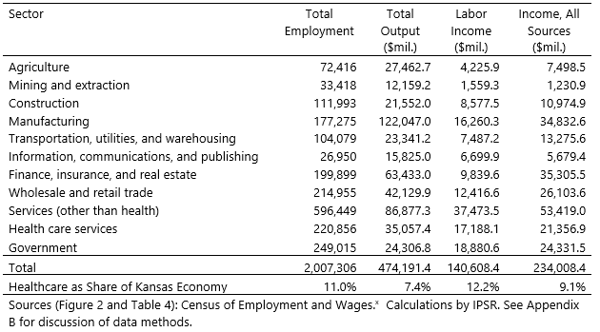
Health Care Income as a Share of the Kansas Economy
Notes:
The size of the health care sector can also be measured in terms of its share of statewide labor income.
Health care workers received just over 12 percent of statewide labor income in 2024.
This labor-income share exceeds the sector’s employment share because many health care jobs pay above the state average.

Slide 5
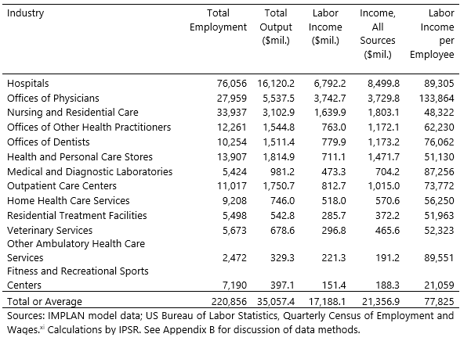
Contributions of Health Care Industries to Employment and Income
Notes:
This table presents the contributions of various health care industries to both employment and labor income (wages and benefits).
We can see that in 2024, health care industries employed roughly 221,000 Kansans, and generated 17.2 billion in direct payroll.
We also note that hospitals, nursing facilities, and physicians’ offices account for the largest shares of health care employment and labor income.
Hospitals alone employ more than 76,000 Kansans and distribute nearly $6.8 billion in wages and benefits.
Hospitals make up approximately 34.4 percent of health care employment, followed by nursing facilities (15.4 percent) and offices of physicians (12.7 percent).
Hospitals are also among the highest-paying industries, with average wages and benefits approaching $90,000.

Slide 6
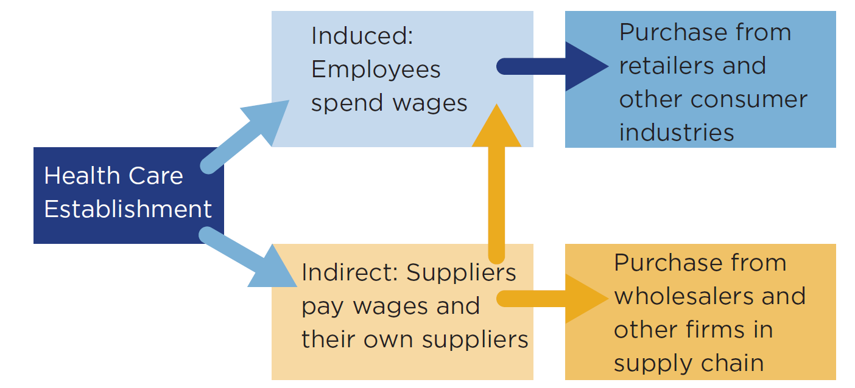
Connections among the Health Care Sector, Consumer Industries, and Suppliers
Notes:
Up to this point, we have considered the “direct” effects of the health care sector on the state’s economy. In other words, we estimated the employment and income generated within the health care sector. But the sector also generates ripple effects through both business-to-business purchases and consumer spending.
Suppose, for example, that a dental office contracts with a Kansas software developer to organize and maintain its appointment records. The software firm uses the receipts from the dental office to pay its own employees. Hence, the health care sector supports part of the employment in the software industry. These types of business-to-business purchases generate what is known as indirect effects – additional increases in employment and labor income in related industries that flow from the operation of the health care sector.
Similarly, Induced effects work through the employer payroll channel. For example, when the dental office pays its office administrator, the income of that administrator will be used in many ways: for instance, to purchase food, pay rent, attend entertainment events and to pay electric bills. All of these downstream industries benefit from interactions with health care employees.
Together, indirect and induced economic impacts are termed “multiplier effects.” Below, we estimate these multiplier effects -- the contribution of the health care sector to employment and income in other sectors.

Slide 7
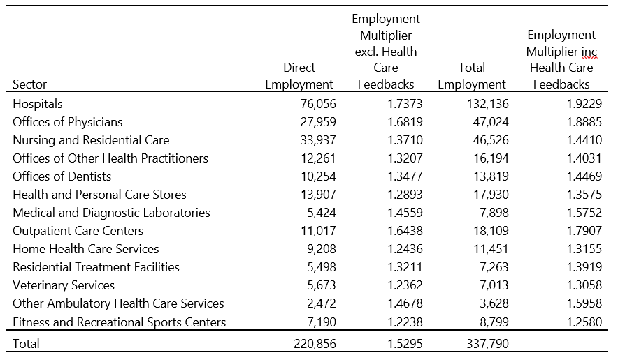
Contributions of Kansas Health Care Industries to Employment
Every 100 jobs in health care supports an additional 53 jobs in other Kansas industries
Notes:
First, we report the total impact of the health care sector on employment, including direct, indirect and induced jobs.
We estimate that the 221,000 direct health care jobs in Kansas support roughly 117,000 additional jobs.
The 76,000 current hospital jobs in Kansas sustain approximately 56,000 additional jobs outside of health care
Said another way, we estimate that every 100 jobs in health care supports an additional 53 jobs in other Kansas industries
And every 100 hospital jobs supports an additional 74 jobs in non-health care sectors.
These additional jobs and income arise in industries such as business services, retail trade, wholesaling, restaurants, and rentals that are connected to health care through supply chain and consumer expenditure linkages.

Slide 8
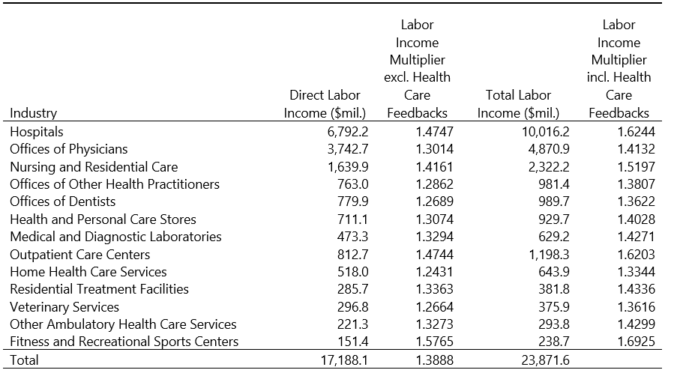
Contribution of Kansas Health Care Industries to Labor Income
Each $1000 in health care wages sustains an additional $389 in wages for other industries.
Notes:
Next, we report the total impact of the health care sector on labor income, including direct, indirect, and induced income.
We estimate that the $17.2 billion in direct labor income to health care sector employees supports an additional $6.7 billion in labor income in linked sectors.
The $6.8 billion in hospital payroll supports and additional $3.2 billion in labor income outside of health care
Put more simply, each $1000 in health care wages sustains an additional $389 in wages for other industries.
And every $1000 in current hospital wages and salaries sustains an additional $475 in income for employees of grocery stores, restaurants, gas and electric utilities, and other industries used by hospitals and their employees.

Slide 9
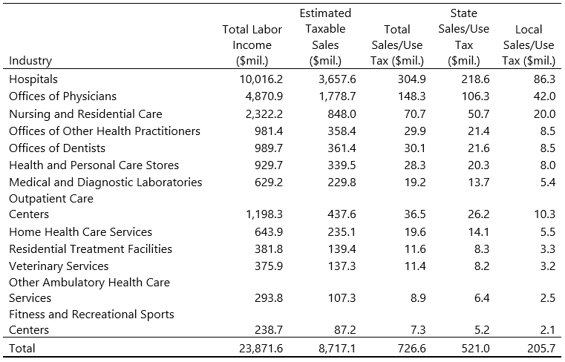
Contributions of Health Care Sector Income to Tax Revenue
Notes:
The health care sector not only sustains employment and income in the Kansas economy—it also supports federal, state, and local government activities through the generation of tax revenue.
We used up-to-date information from the Kansas Department of Revenue (KDOR) to estimate the effect of income in the health care sector on sales and use tax collections.
We estimate that labor income generated by the health care sector supports approximately $521 million in state sales and use tax revenue and an additional $206 million in local sales and use taxes for counties, cities, and special districts.

Slide 10
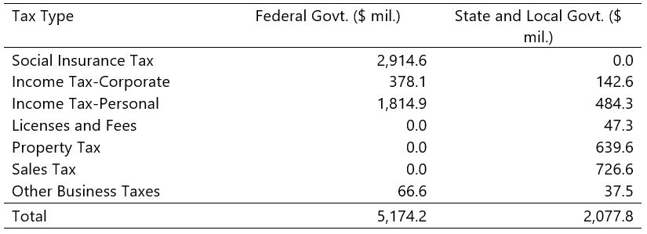
Overall Contributions of Health Care Sector to Tax Revenue
We estimate that the health care sector contributes 9.9 percent of tax revenue in Kansas
Notes:
The health care sector in Kansas generates other federal, state and local taxes. We use results from the IMPLAN model to estimate the overall tax impact.
We find that, in 2024, the health care sector generated $5.2 billion in federal tax revenue and $2.1 billion in state and local tax revenue
The Kansas Legislative Research Department estimates that Kansas collected a total of about $20.8 billion in combined state and local revenue in fiscal year 2024, so we estimate that the health care sector contributes about 9.9 percent of tax revenue in Kansas.

Slide 11
Additional Effects of Health Care on Economic Development
Links Between Population Health and Economic Growth
Reducing Health-Related Productivity Losses
Preventing Premature Exits from the Labor Market
Attracting and Retaining Workers and Businesses
Attracting and Retaining Older Adults in the Community
Notes:
In addition to the quantifiable impacts of the health care sector in Kansas, a substantial body of research suggests that a robust health care sector confers additional benefits for economic development and labor force sustainability that are beyond the scope of a traditional economic impact analysis.
Recent research reinforces the idea that a strong health care sector is a core component of a state’s economic infrastructure.
The health care sector supports worker productivity by preventing and managing chronic disease and mental health conditions
health systems help sustain labor force participation and productivity, reduce caregiver-related productivity losses, and delay premature exits from the labor market.
At the same time, hospitals and health care services function as valued community amenities that influence where businesses, workers, and older adults choose to locate, supporting both in-migration and aging in place.
These broader, hard-to-quantify benefits sit alongside the more traditional employment and income effects captured by IMPLAN, underscoring that investments in health care are also investments in long-run economic vitality and development for Kansas

Slide 12
Questions?

