Slide 1

KAHCC Innovation Spring Conference
Using Data to Get Results
04/25/24
VVV Consultants LLC
Olathe, Kansas 66061
Vince Vandehaar MBA
VandehaarMarketing.com
913-302-7264

Slide 2
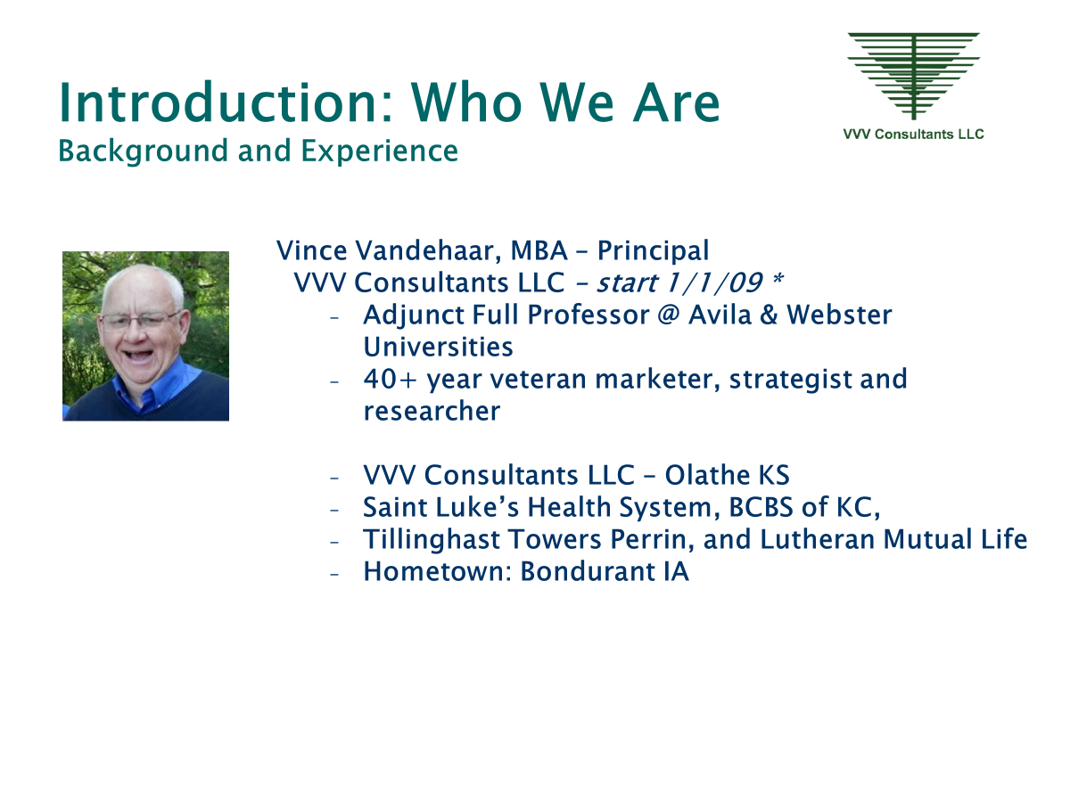
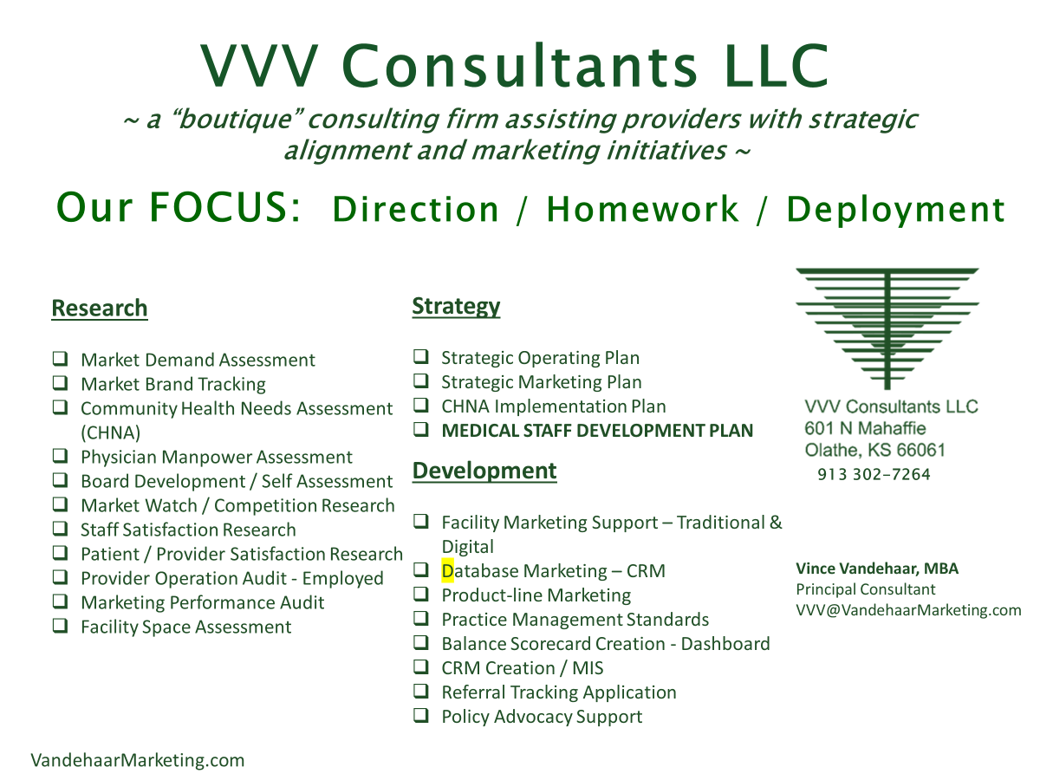
Topics to cover (10 mins)
Introduction / Background
Align Marketing Initiatives to Strategic Plan. Determine Source files & Measurements by Pillar. KEY Areas to Market… have a)Capacity, b) Tremendous Quality, and c) profitable (make a $1) with 3 Exceptions... Primary Care, OB, and ER
Marketing Information System (MIS)
Specific Questions to address:
  What KPIs (Key Performance Indicators) to measure (meaningful to Admin and you) Benchmark … set GOALS
  New Marketers … Suggestions to start to assess local marketing data?
  Questions

Slide 3
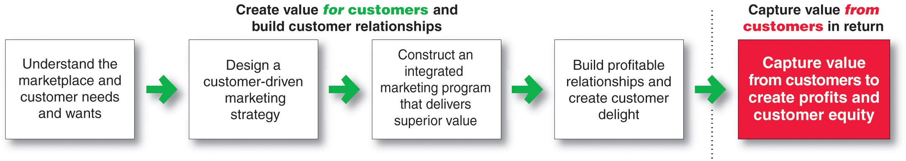
Marketing & Planning Alignment
> Marketing Link to Strategic Plan
> Marketing Plan Development Flow - Marketing Mix
VVV Consultants LLC Dec 2016

Slide 4
Measure Internal Functions

Slide 5
Prepare Marketing Assumptions (Blueprint with Success Measures)

Slide 7
Track Peers – Media Activities

Slide 9


Questions
Vince Vandehaar MBA
VVV@VandehaarMarketing.com
(913) 302-7264

