Slide 1



Slide 2

The modern marketer is an experimenter, a lover of data, a content creator, a justifier of ROI.
Kim Walsh

Slide 3


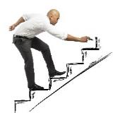

Winning Combination
Purpose & Strategy
MATCH
messages and delivery in a way that is both engaging and unobtrusive to audiences
Lead Gen
IDENTIFY
and solve pain points (needs) for customers
Reputation Mgmt
Mail Automation*
Social Media
DRIVE
business goals in measurable and accountable ways
Web, Mobile, SEO
User-Friendly & Data Driven
PROVIDE
internal communication to ensure patient/staff safety or our ability to do business
*in progress of implementation

Slide 4
Project Brief Timeline
$$$ Major | $$ Minor | $ Micro | Organic/No Cost
$$ Recruitment – B2C
$ Occ Med – B2B
$ SBHC/IRU – B2B
$$ Arthritis (Ortho) – B2C, B2B, B2P
$$ FM | Annual Wellness – B2C, B2P
IC | Sprains, Sinus Infections- B2C
$$ Wound Care – B2B, B2C
ED Expansion – B2B, B2C
$ Allergies – B2B, B2C, B2P
$ IC | Sports Physicals – B2C
$ Diabetes Education – B2B, B2C, B2P
$$ FM | Annual Wellness – B2C
$$ Recruitment – B2C
$$ PT & Rehab – B2C
MM – Vendor Change
ED Expansion – B2B, B2C
March
May
February
April
June
IC | Flu Season – B2C
$ Heart Month – B2C
$$ Arthritis (Ortho) – B2C, B2B, B2P
$$ FM | Annual Wellness – B2C, B2P
$ Urology – B2B
$$ Ortho – B2B, B2P
$ Cardiac Rehab – B2B
$$ Recruitment – B2C
ED Expansion – B2B, B2C
$ Allergies – B2B, B2C, B2P
$$$ FM | Annual Wellness– B2C, B2P
$$ PT & Rehab – B2C, B2B, B2P
$ Diabetes Education – B2B, B2C, B2P
$$ Recruitment – B2C
Reputation Management – Ph III Go Live
Material Management – Vendor Change
ED Expansion – B2B, B2C
$$ Recruitment – B2C
$$ PT & Rehab – B2C
$ IC | Sports Physicals – B2C
$ Lactation – B2C, B2B, B2P
$$ FM | Annual Wellness – B2C
Website 2.0 – B2B
TBD – B2B
Coming This Fall
$ Migraines (Neuro) – B2B, B2C, B2P
$$ Sports Med – B2C, B2B, B2P
$ IC | Sports Physicals – B2C

Slide 5

Project Briefs
Using as many tools in our toolbox as possible to connect messages to audiences that generate leads and potential patients.

Slide 6
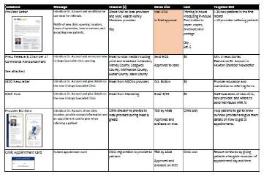
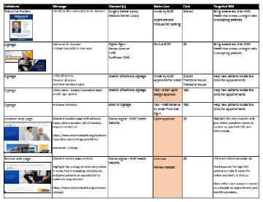
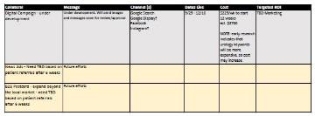
Project Briefs
$$$ Major | $$ Minor | $ Micro | Organic/No Cost
Research, Opps, Messages
Direct Mail - postcards, letters, other
Earned media - press releases, community newsletters, recognitions
Internal Communication – MSO/Staff News, other
Literature - bio/appt cards, brochures, flyers, guidebooks, other
POS - posters, table tents
Print ads – newspaper, industry/community pubs
Signage - directory, room, digital, roadside, other
Website - SEO, content, location/service/provider page, CTAs, home banner, referring sites
Blogs & White Papers
Social Media - Facebook, Instagram, Twitter, LinkedIn, posts, groups
Forms – web surveys, referral, other
Digital Campaign - social media, Google display/search, other
Testimonials – web, social, other
Video production
Events – community, ribbon cutting, other
PT experience/workflows
Provider education
Branded & promo items
Photos

Slide 7
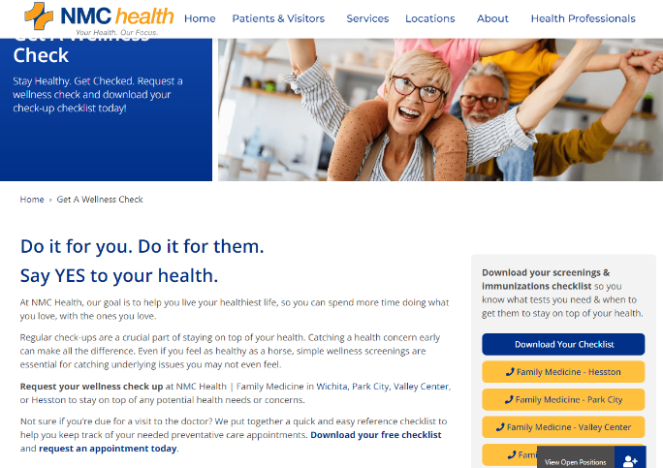
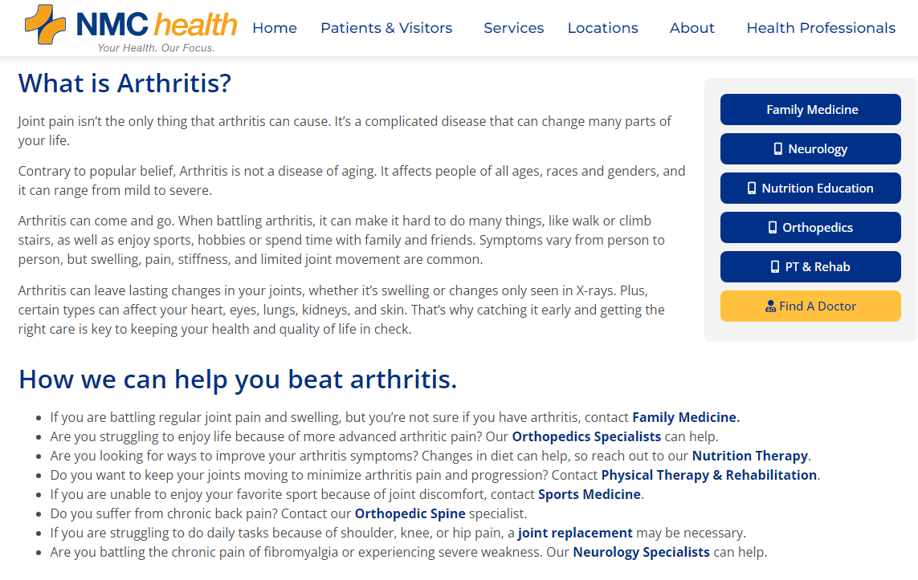
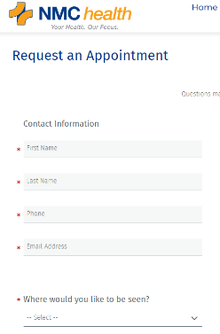
Lead Gen – Web Pages/Blogs with Conversions

Slide 8


Lead Gen – UTMs & QR Codes

Slide 9
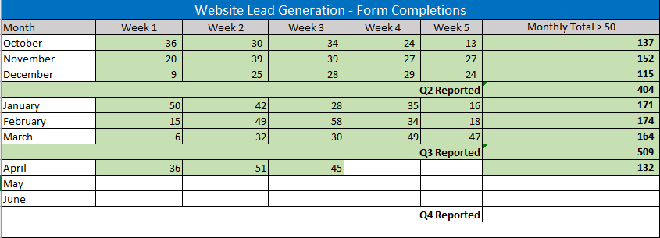
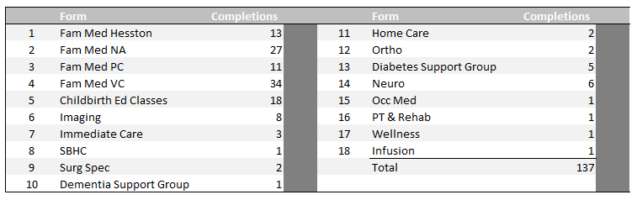
Tools We Use
QuestionPro (Quality Surveys tool)
Approx.40 forms live on site

Slide 10
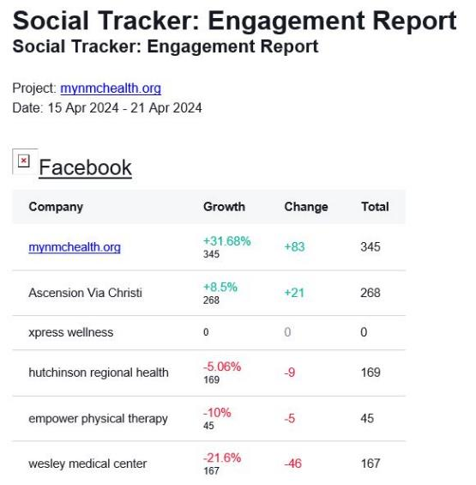
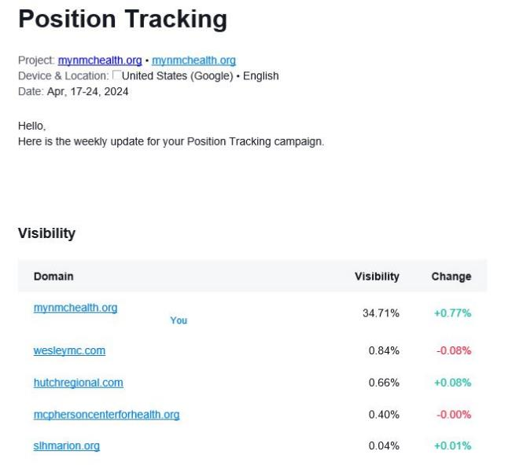
Tools We Use
SEMrush

Slide 11
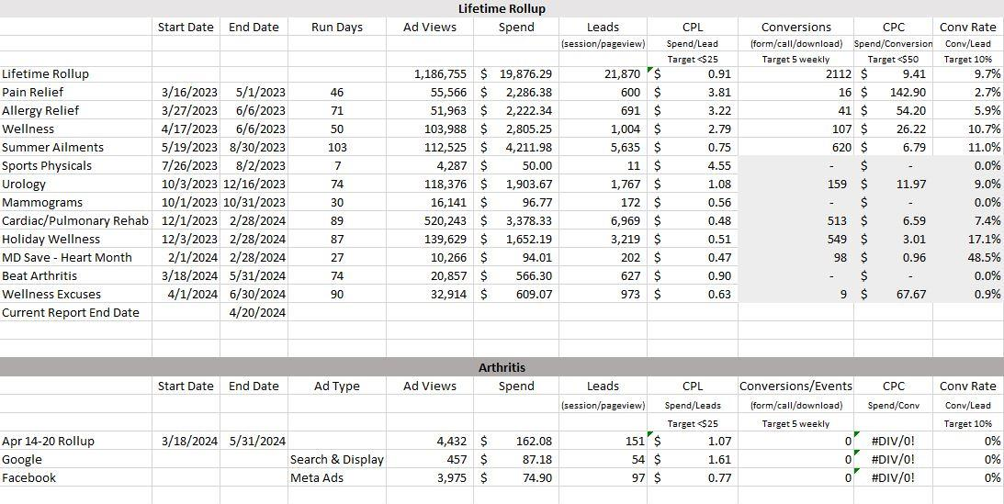
Tools We Use
Ads Managers

Slide 12
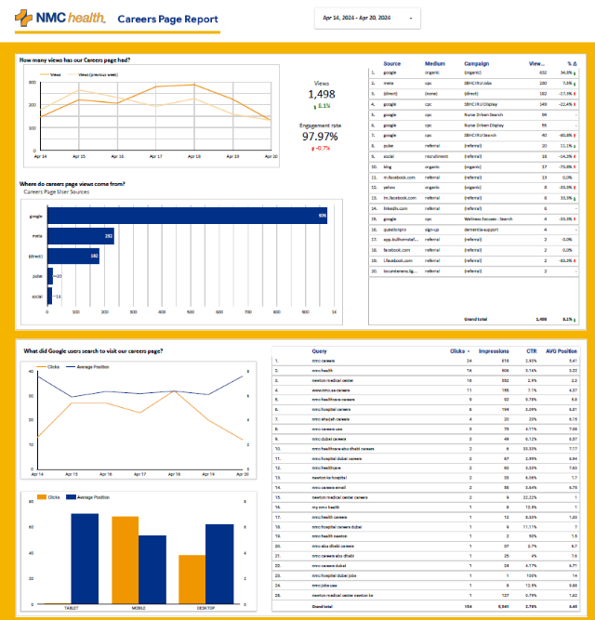
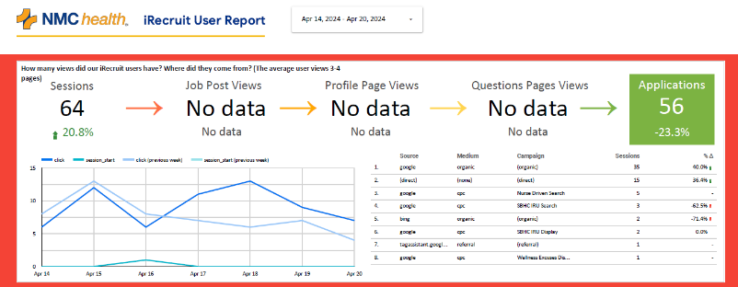
Tools We Use
GA4 + Looker Studio

Slide 13
Tools We Use
rater8
SINCE GO LIVE – 12/13/23
LOCATION RATING PRIOR CURRENT CHANGE
Family Medicine – Hesston 4.8 4.9 +0.1
Family Medicine – North Amidon 3.2 4.3 +1.1
Family Medicine – Park City 3.0 4.6 +1.6
Family Medicine – Valley Center 4.5 4.9 +0.4
Neurology Specialists 3.4 4.8 +1.4
Orthopedics & Sports Specialists 3.5 4.9 +1.4
Urology Specialists 0 4.6 +4.6
Emergency Medicine 2.4 4.0 +1.6
Medical Center 2.6 2.8 +0.2
Surgery Center 5.0 5.0 --
Surgical Specialists 5.0 5.0 --
Wound Healing & Hyperbaric Center 5.0 5.0 --
11,636 review requests sent
3,340 responses (rating clicks) – 28.7%
Industry avg – 25%
615 patient comments
964 online reviews added – 8.28%
Industry avg < 6%

Slide 14




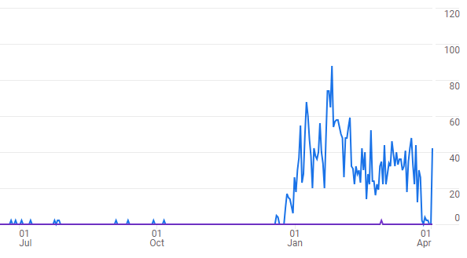
Project Briefs – NY Wellness: Say Yes
$$$ Major | $$ Minor | $ Micro | Organic/No Cost
Tactics:
B2B MSO newsletter (cardiac CT scores)
B2C social, paid Google/Meta, digital signs, web page updates, blogs
B2P exam room posters
Results:
87 Days
139,629 views, 3,219 leads
$1652.19, $0.51/lead ($25 ind.)
MDsave CT Scores - $94.01 for 202 leads @ $0.47 each (98/126 Feb scans)

Slide 15





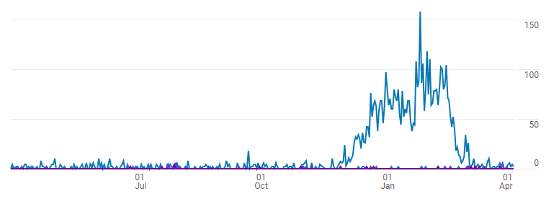
Project Briefs – Cardiac Rehab
$$$ Major | $$ Minor | $ Micro | Organic/No Cost
Tactics:
B2B postcards, referral letters, forms, MSO newsletter
B2C social, paid Google/Meta, digital signs, web page updates, blogs
B2P clinic/case mgmt literature
Results:
89 Days
520,248 views, 6,969 leads
$3378.33, $0.48/lead ($25 ind.)

Slide 16

Building a New Robot to Move the Needle
Cardiac/Pulmonary Rehab – Preliminary Report
Then - Capacity to grow both services
60% & 77% of referrals coming from one provider in each service line
Majority of referring providers only had one referral in the past year
1/23/24 – Campaign still in progress
Weather caused lower numbers with cancellations, so delayed results
Patients are calling directly to request admissions (use new referral forms)
2 new providers are referring patients (2 weeks after first direct mail)
Amirani is only referring 1/10 patients (not 6/10)
We are seeing other referring providers referring multiple patients again
Referral Forms
Provider Direct Mail
Social Media (B2C)
Internal Workflows

Slide 17

Any Questions?

Slide 18

HOLLER!
  KEEPING IT AS CLEAR AS MUD
  SHELLY CONRADY
316.804.6006
shelly.conrady@mynmchealth.org
mynmchealth.org

