Slide 1
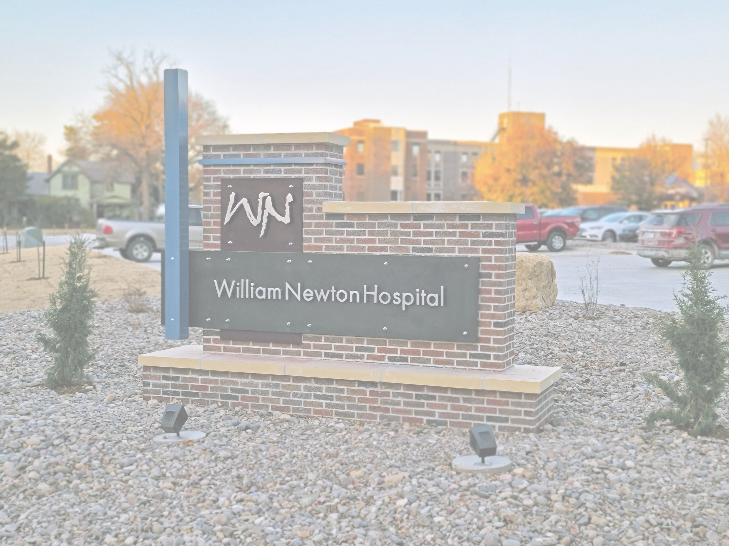

Sarah Johnson
DIRECTOR OF MARKETING, STRATEGY & COMMUNICATIONS

Slide 2
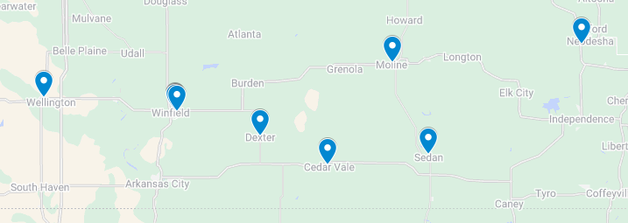
Our Network

Slide 3


William Newton Cardiology & Cath Lab

Slide 4
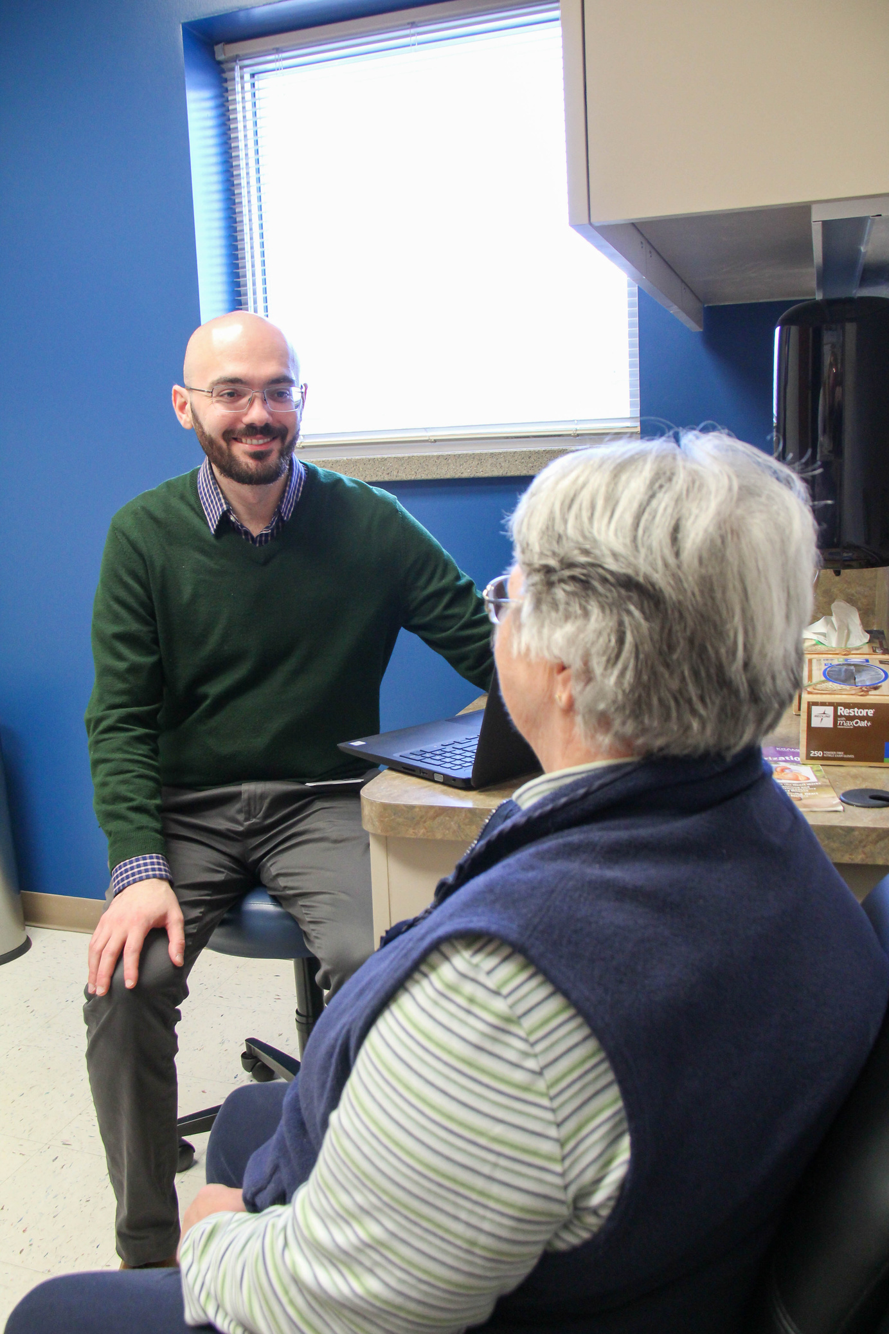
Within the first 6 mos
BRANDING:
MEDIA & ADVERTISING:
  Logo & Design
  Internal Slogan Contest
  Original Photography
  Merch & Promo Items
  Direct Mail - Special Newsletter
  Newsprint
  Outdoor Media
  Point-of-Sale
  Radio
  Screen Media
  Social Media
  Webpage & Provider Directory
DIRECT SELLING:
  In-person introductions & luncheon w/referring providers
  Open House
  VIP Meet & Greet
STORYTELLING:
  Meet the Provider Video
  News Releases & Feature Articles

Slide 5
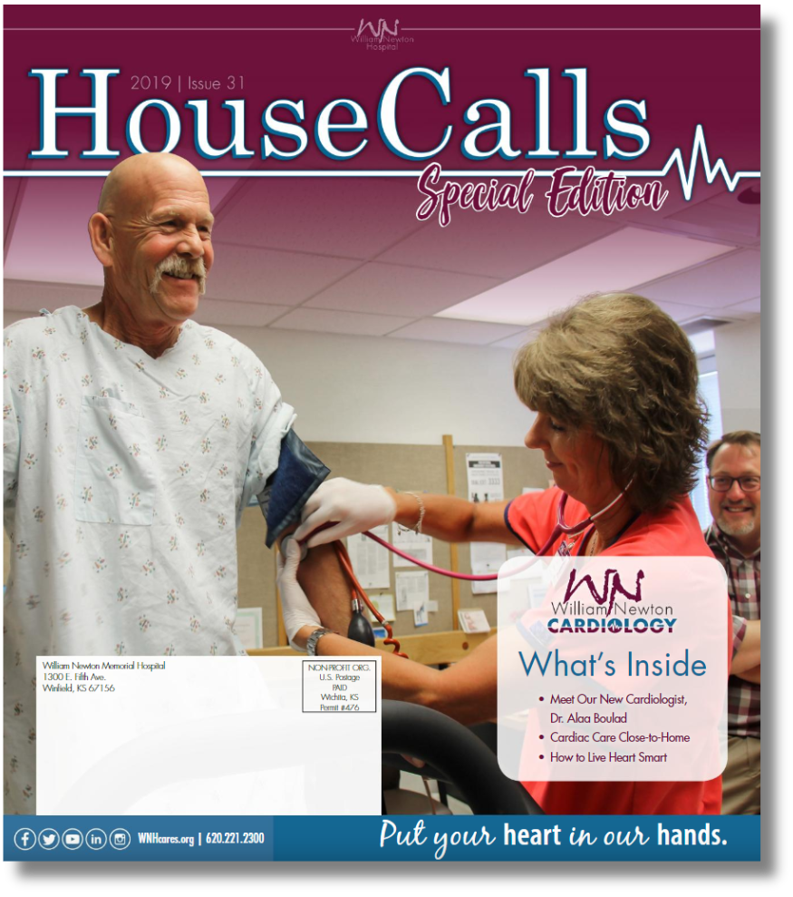

Slide 6
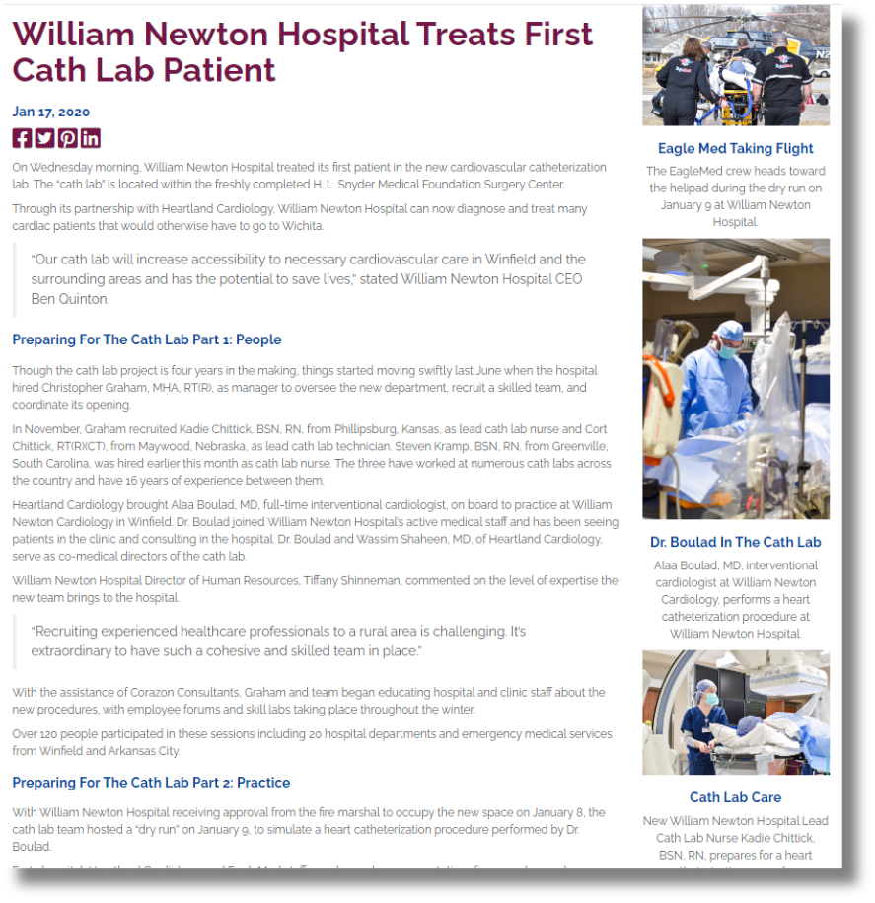

Slide 7

& again 18 mos. later w/new provider
DIRECT SELLING:
MEDIA & ADVERTISING:
  Health Fairs
  In-person introductions & luncheon w/referring providers
  VIP Meet & Greet
  Direct Mail - Annual Newsletter
  Newsprint
  Outdoor Media
  Point-of-Sale
  Radio
  Screen Media
  Social Media
  Webpage & Provider Directory
STORYTELLING:
  Meet the Provider Video
  News Releases & Feature Articles
CONTENT MARKETING:
Health Column

Slide 8


Slide 9


Slide 10
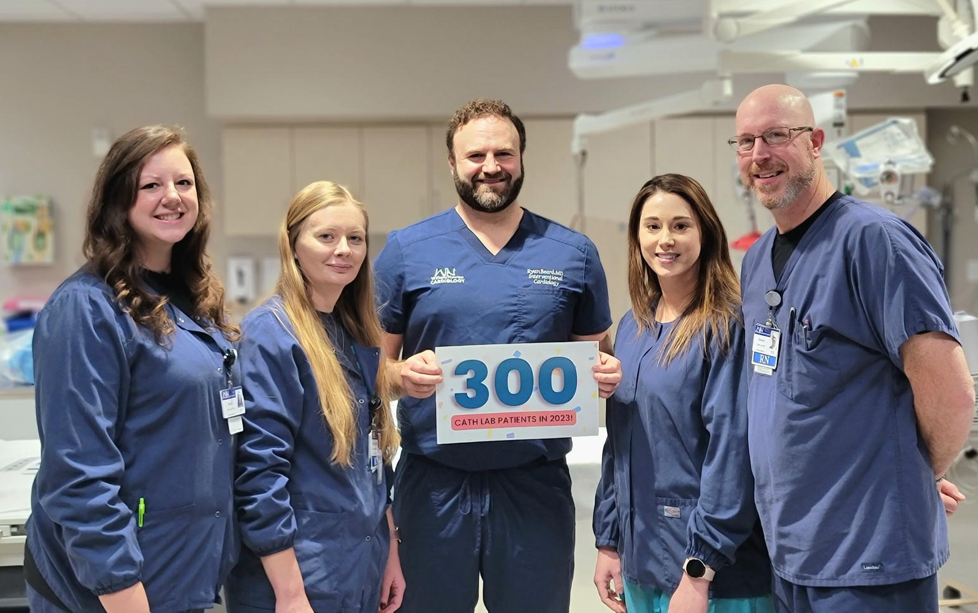
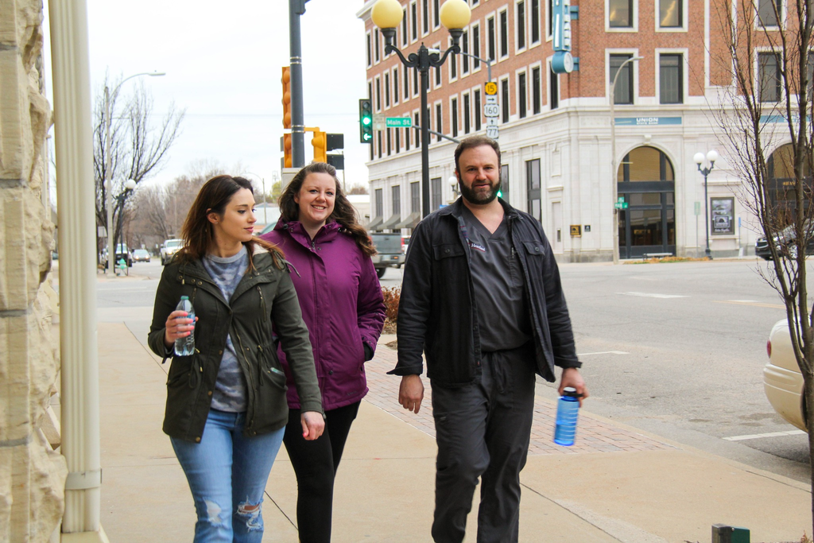
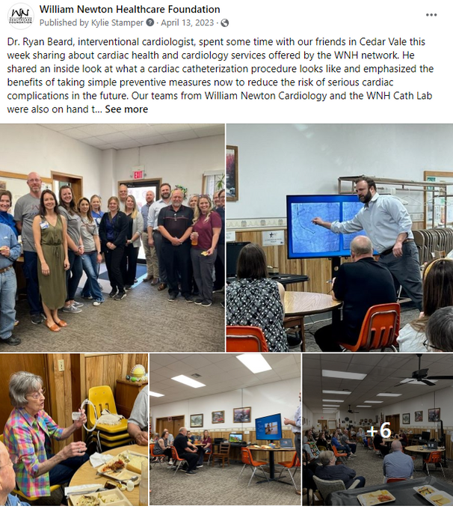
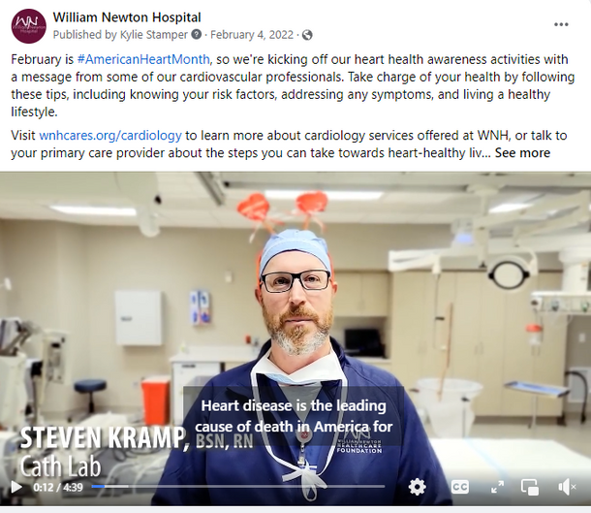
More... over the next 2 years
DIRECT SELLING:
  Speakers Bureau
CONTENT MARKETING:
  Heart Health Video
  Blogs
MEDIA & ADVERTISING:
  Digital SEM & Display Ads
  Health Observations
  Service Line Milestones
  Social Media - Targeted Ads

Slide 11


Onboarding Dr. Rebekah Ross & Sunflower OB/GYN

Slide 12
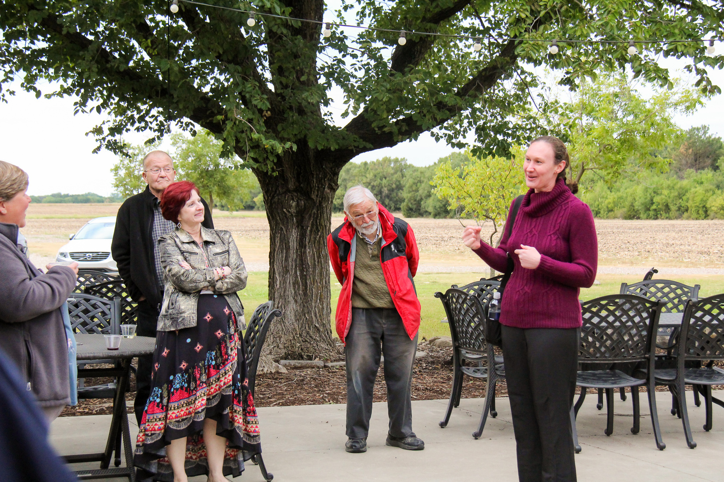
Within the first 3 mos
RE-BRAND:
DIRECT SELLING:
MEDIA & ADVERTISING:
  Logo & Design
  Original Photography
  Collateral Materials for clinic
  In-person introductions at referring provider clinics
    11 clinics over 3 days in 4 counties
  VIP Meet & Greet
  Newsprint
  Point-of-Sale
  Radio
  Social Media
  Hospital Provider Directory
  Clinic Website
STORYTELLING:
  News Releases & Feature Articles
  Meet the Provider Video

Slide 13



Slide 14



Slide 16
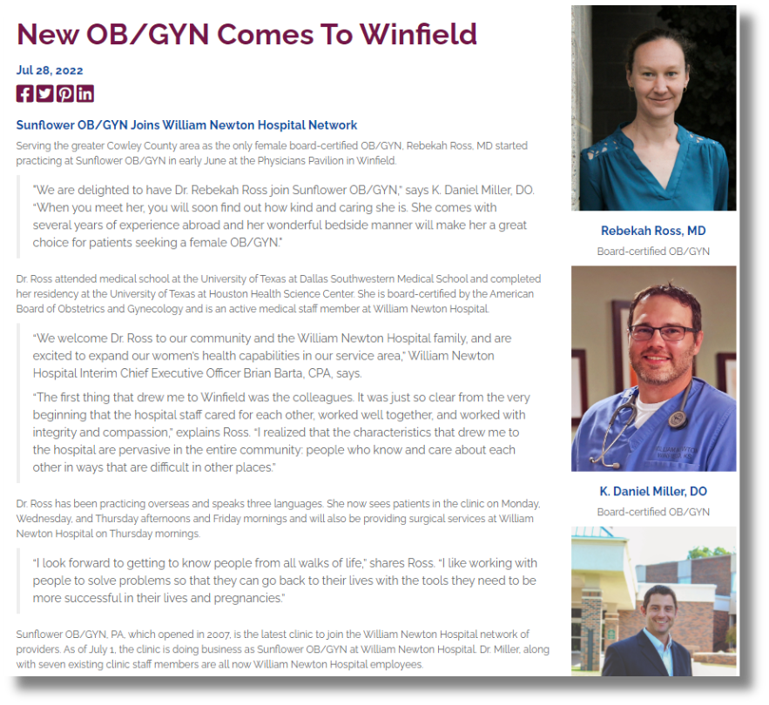

Slide 17
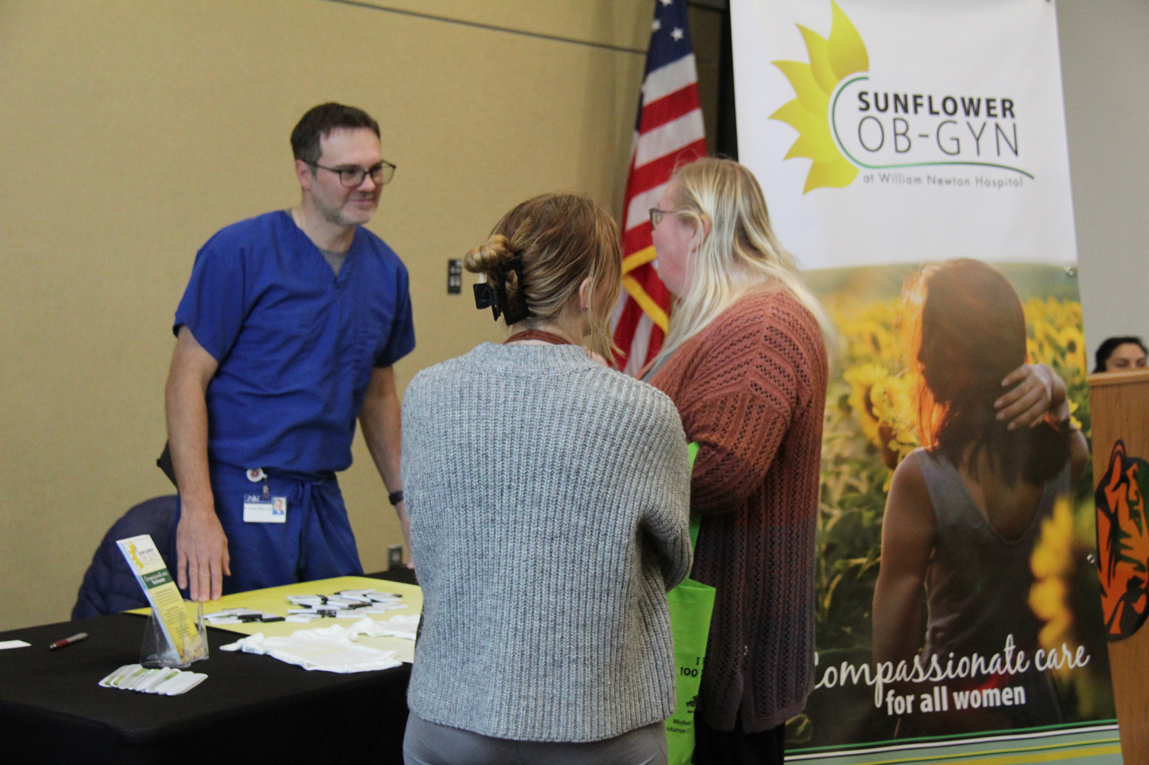


More... over the next
9 months
DIRECT SELLING:
  Civic Meetings
  Health Fair
MEDIA & ADVERTISING:
  Digital SEM & Display Ads
  Direct Mail - Annual Newsletter
  Outdoor Media
  Screen Media

Slide 18


Slide 19
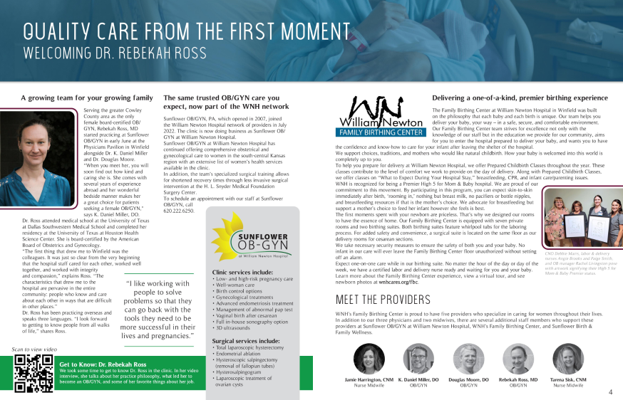

Slide 20
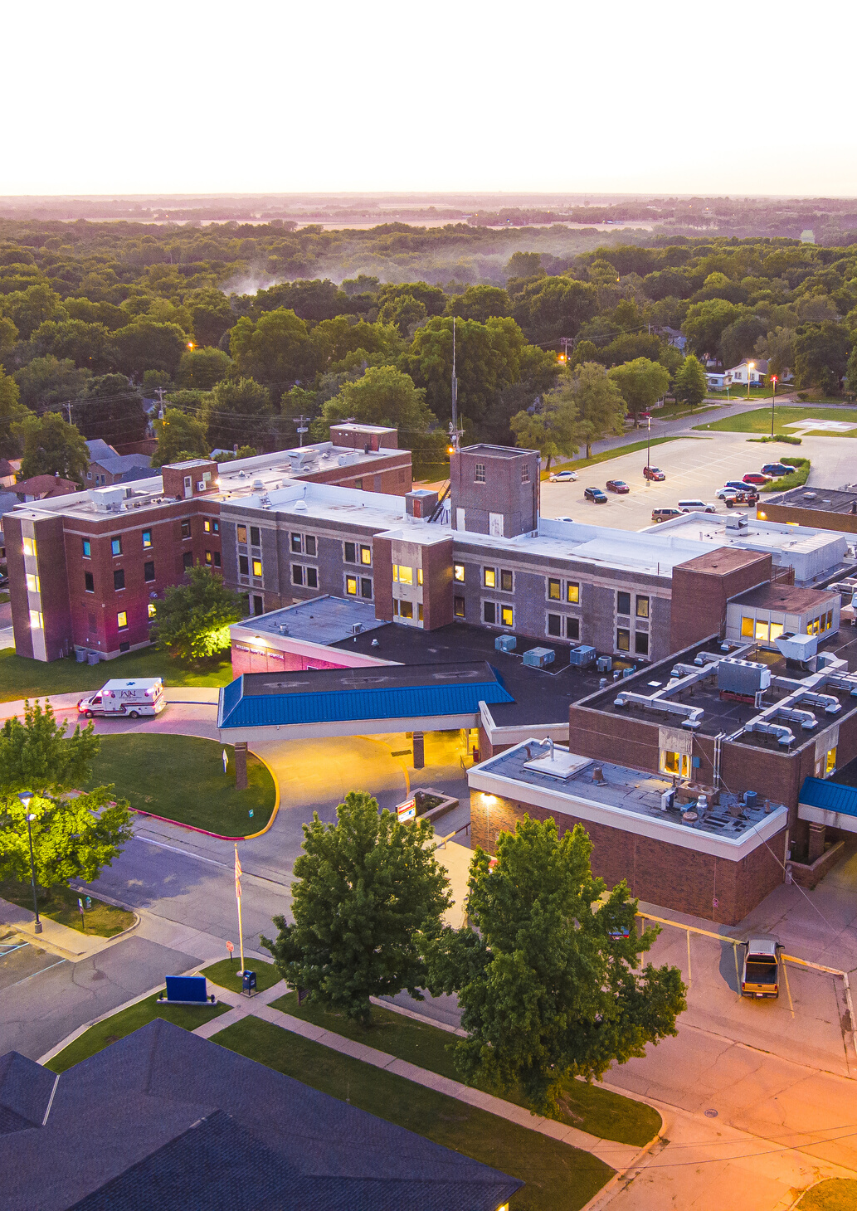
What’s worked
  Create an Onboarding Checklist
  Develop a Blueprint
  Adapt to Your Provider & Budget

