Slide 1







Wardiere Inc.
MARKETING NEW PROVIDERS AND SERVICE LINES
Megan Carmichael,
Director of Marketing & Communications
Page 01

Slide 2

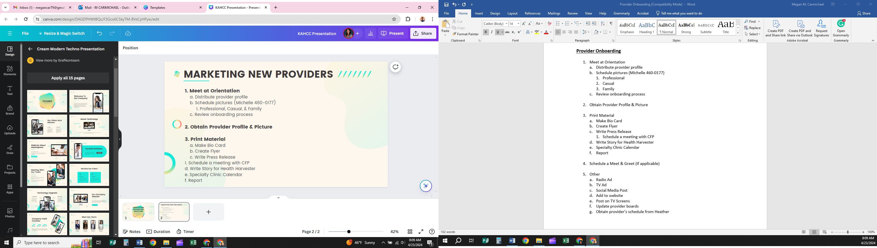
MARKETING NEW PROVIDERS

Slide 3
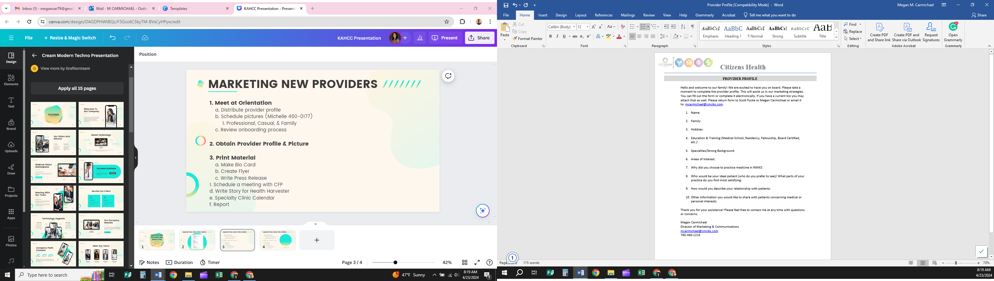
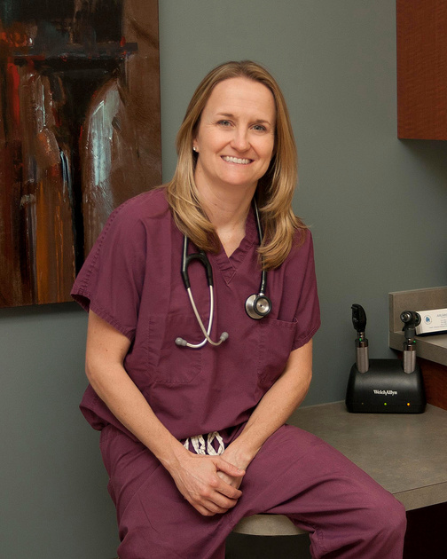
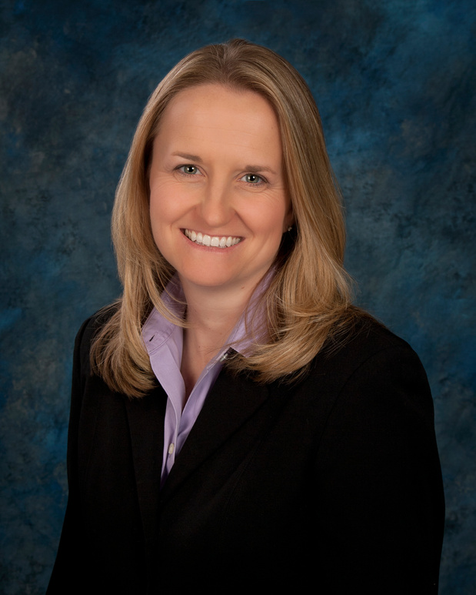


MARKETING NEW PROVIDERS
1. Meet at Orientation
a. Distribute provider profile
b. Schedule pictures (Michelle 460-0177)
1. Professional, Casual, & Family
c. Review onboarding process
2. Obtain Provider Profile & Picture

Slide 4
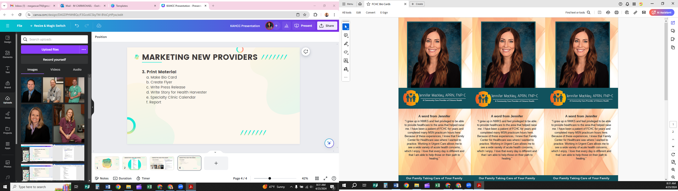
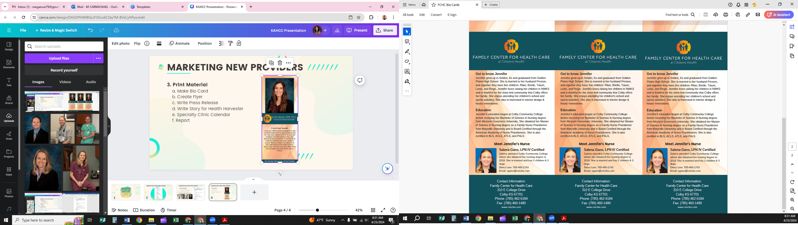

MARKETING NEW PROVIDERS
3. Print Material
a. Make Bio Card
b. Make/ Order Business Cards
c. Create Flyer
d. Write Press Release
e. Write Story for Health Harvester
f. Specialty Clinic Calendar
g. Report

Slide 5
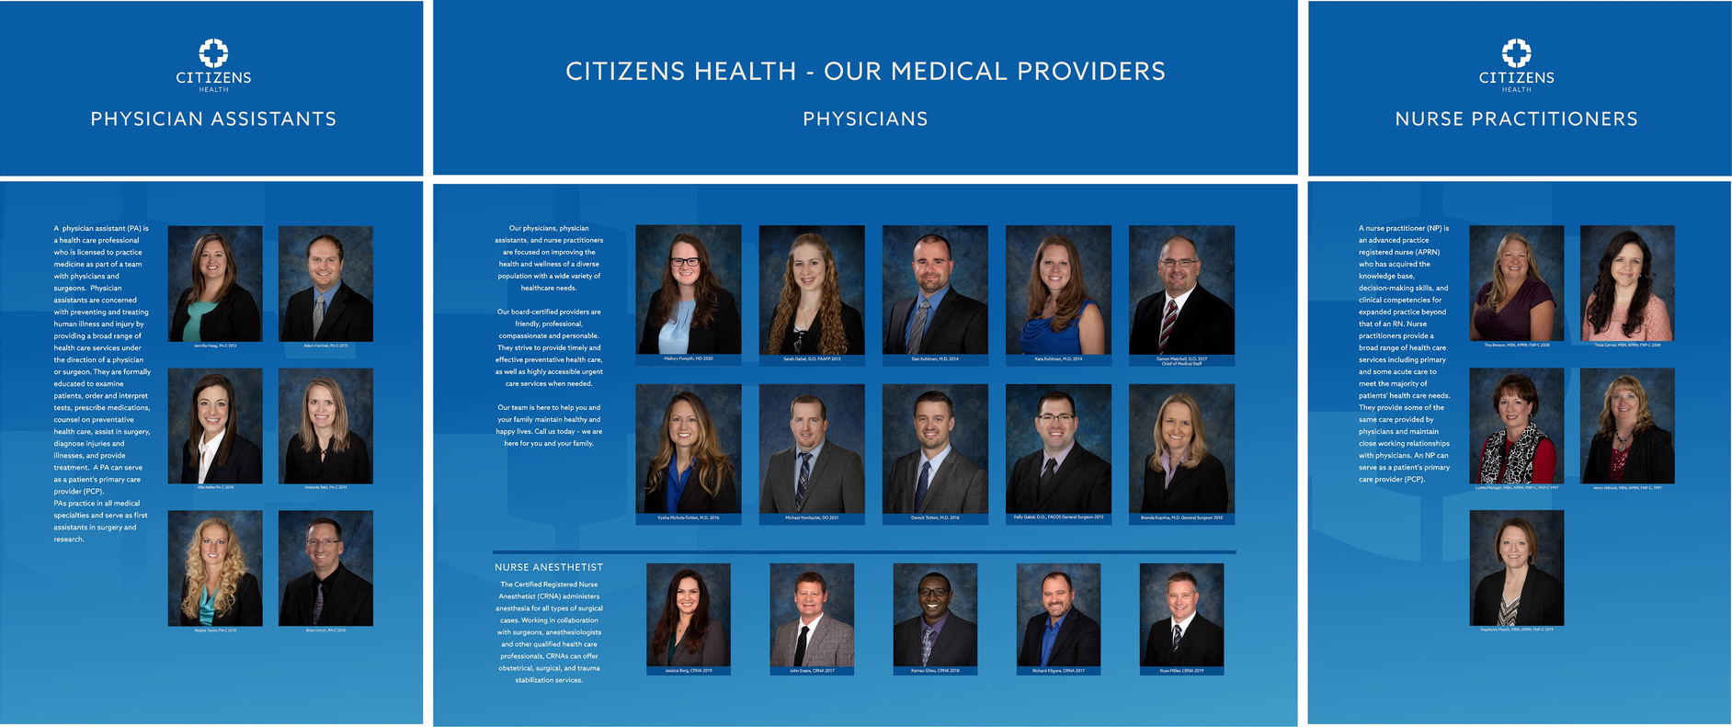
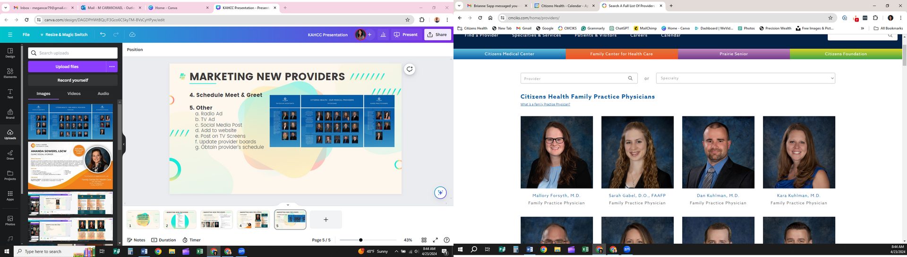
MARKETING NEW PROVIDERS
4. Schedule Meet & Greet
5. Other
a. Radio Ad
b. TV Ad
c. Social Media Post
d. Add to website
e. Post on TV Screens
f. Update provider boards
g. Obtain provider’s schedule
KEY TAKEAWAYS
  Every organization is different, do what works best for you & your community
  Keep track of what you do, have a plan
  Be consistent

Slide 6
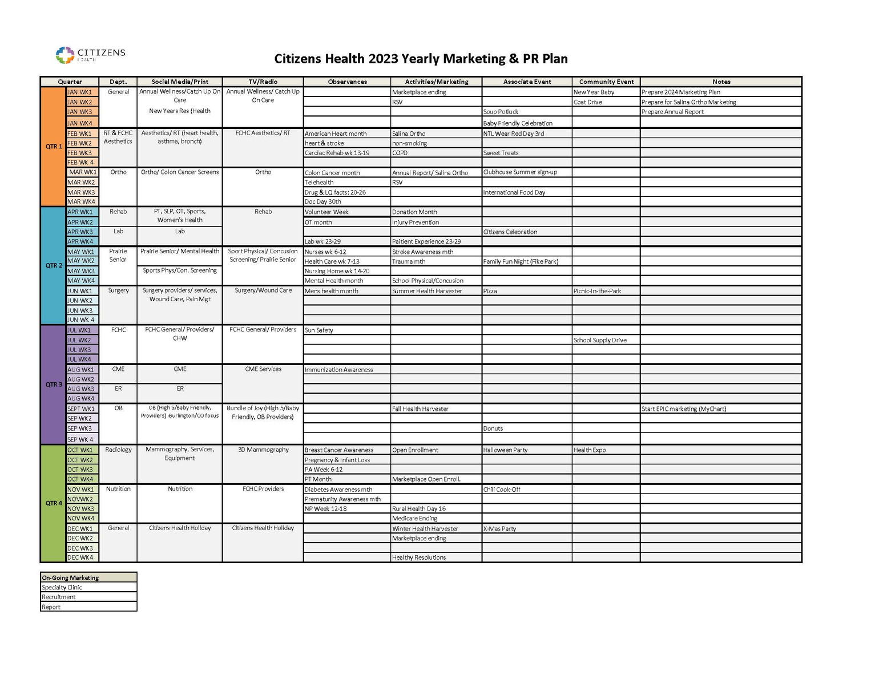
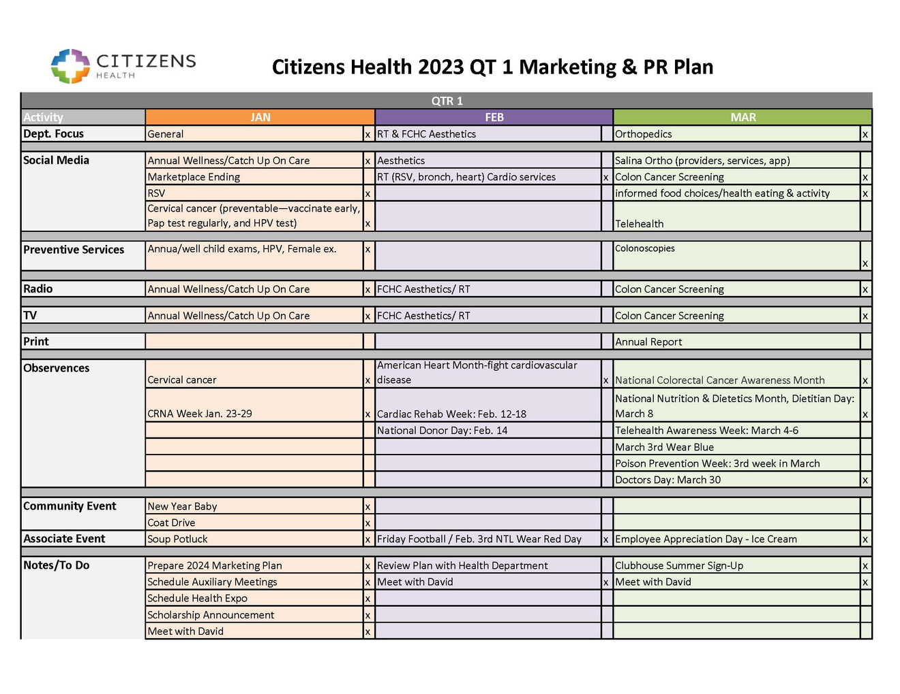
MARKETING NEW SERVICE LINES
Setting my yearly marketing goals

Slide 7
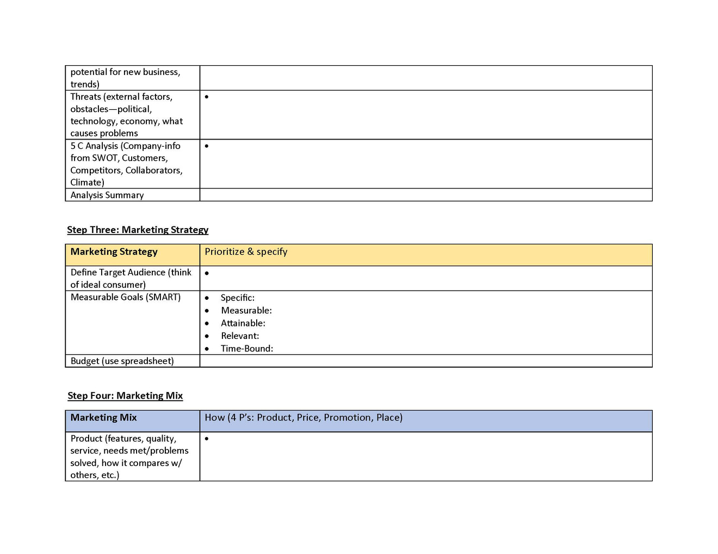
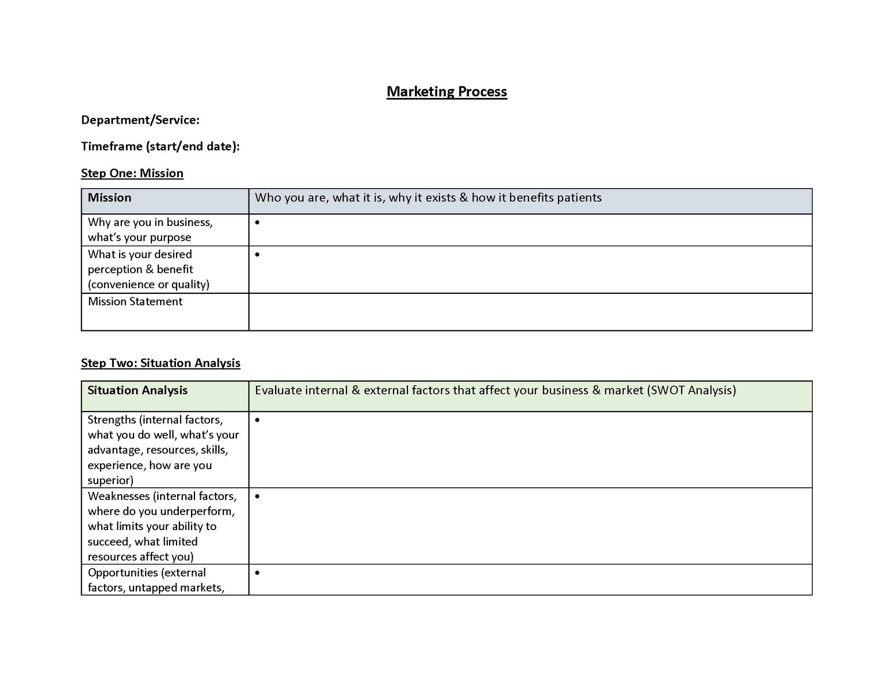
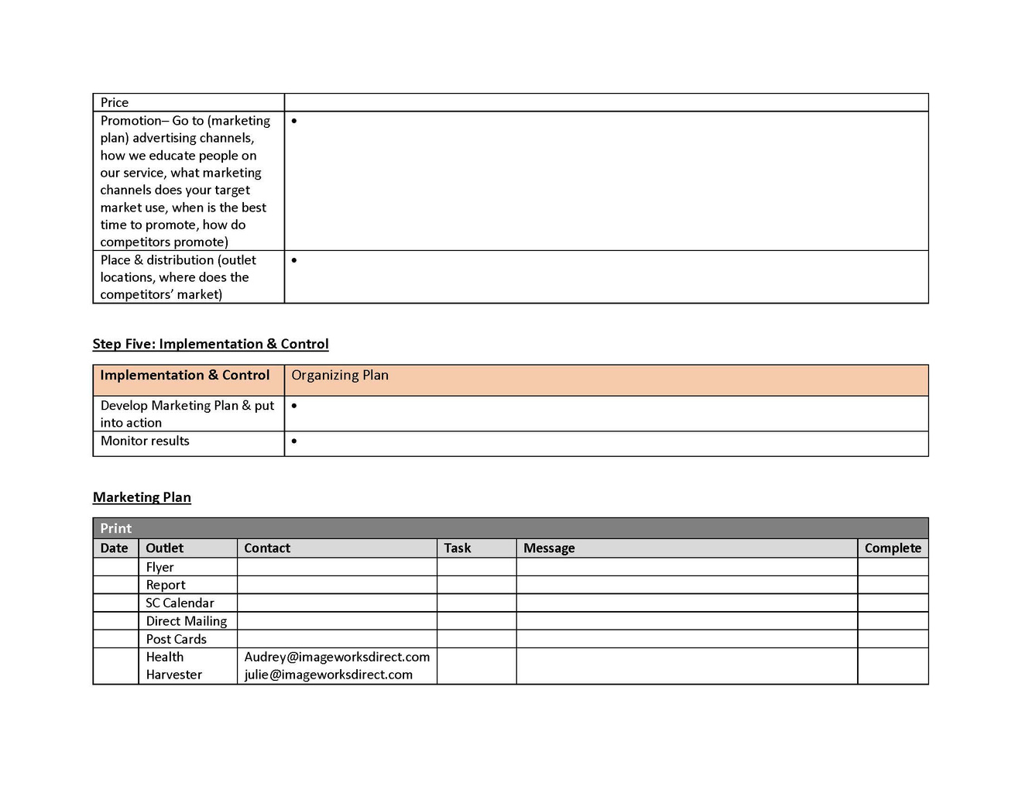
MARKETING PROCESS

Slide 8
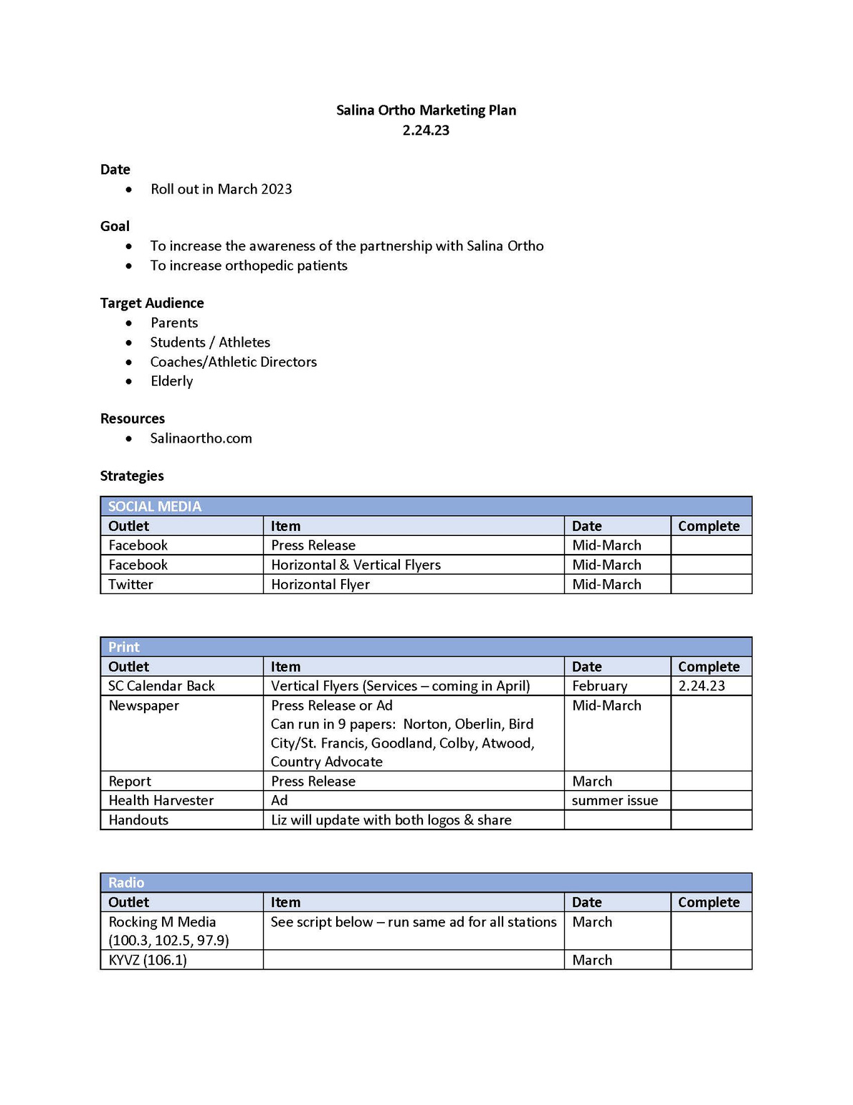
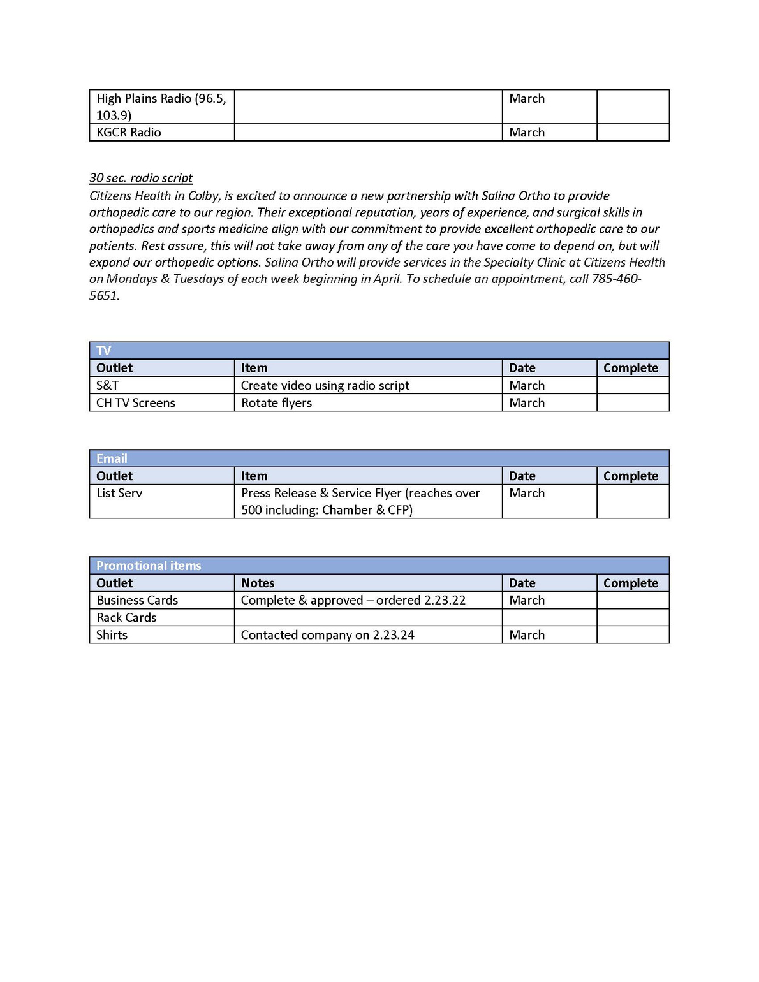

Slide 9


