Slide 1
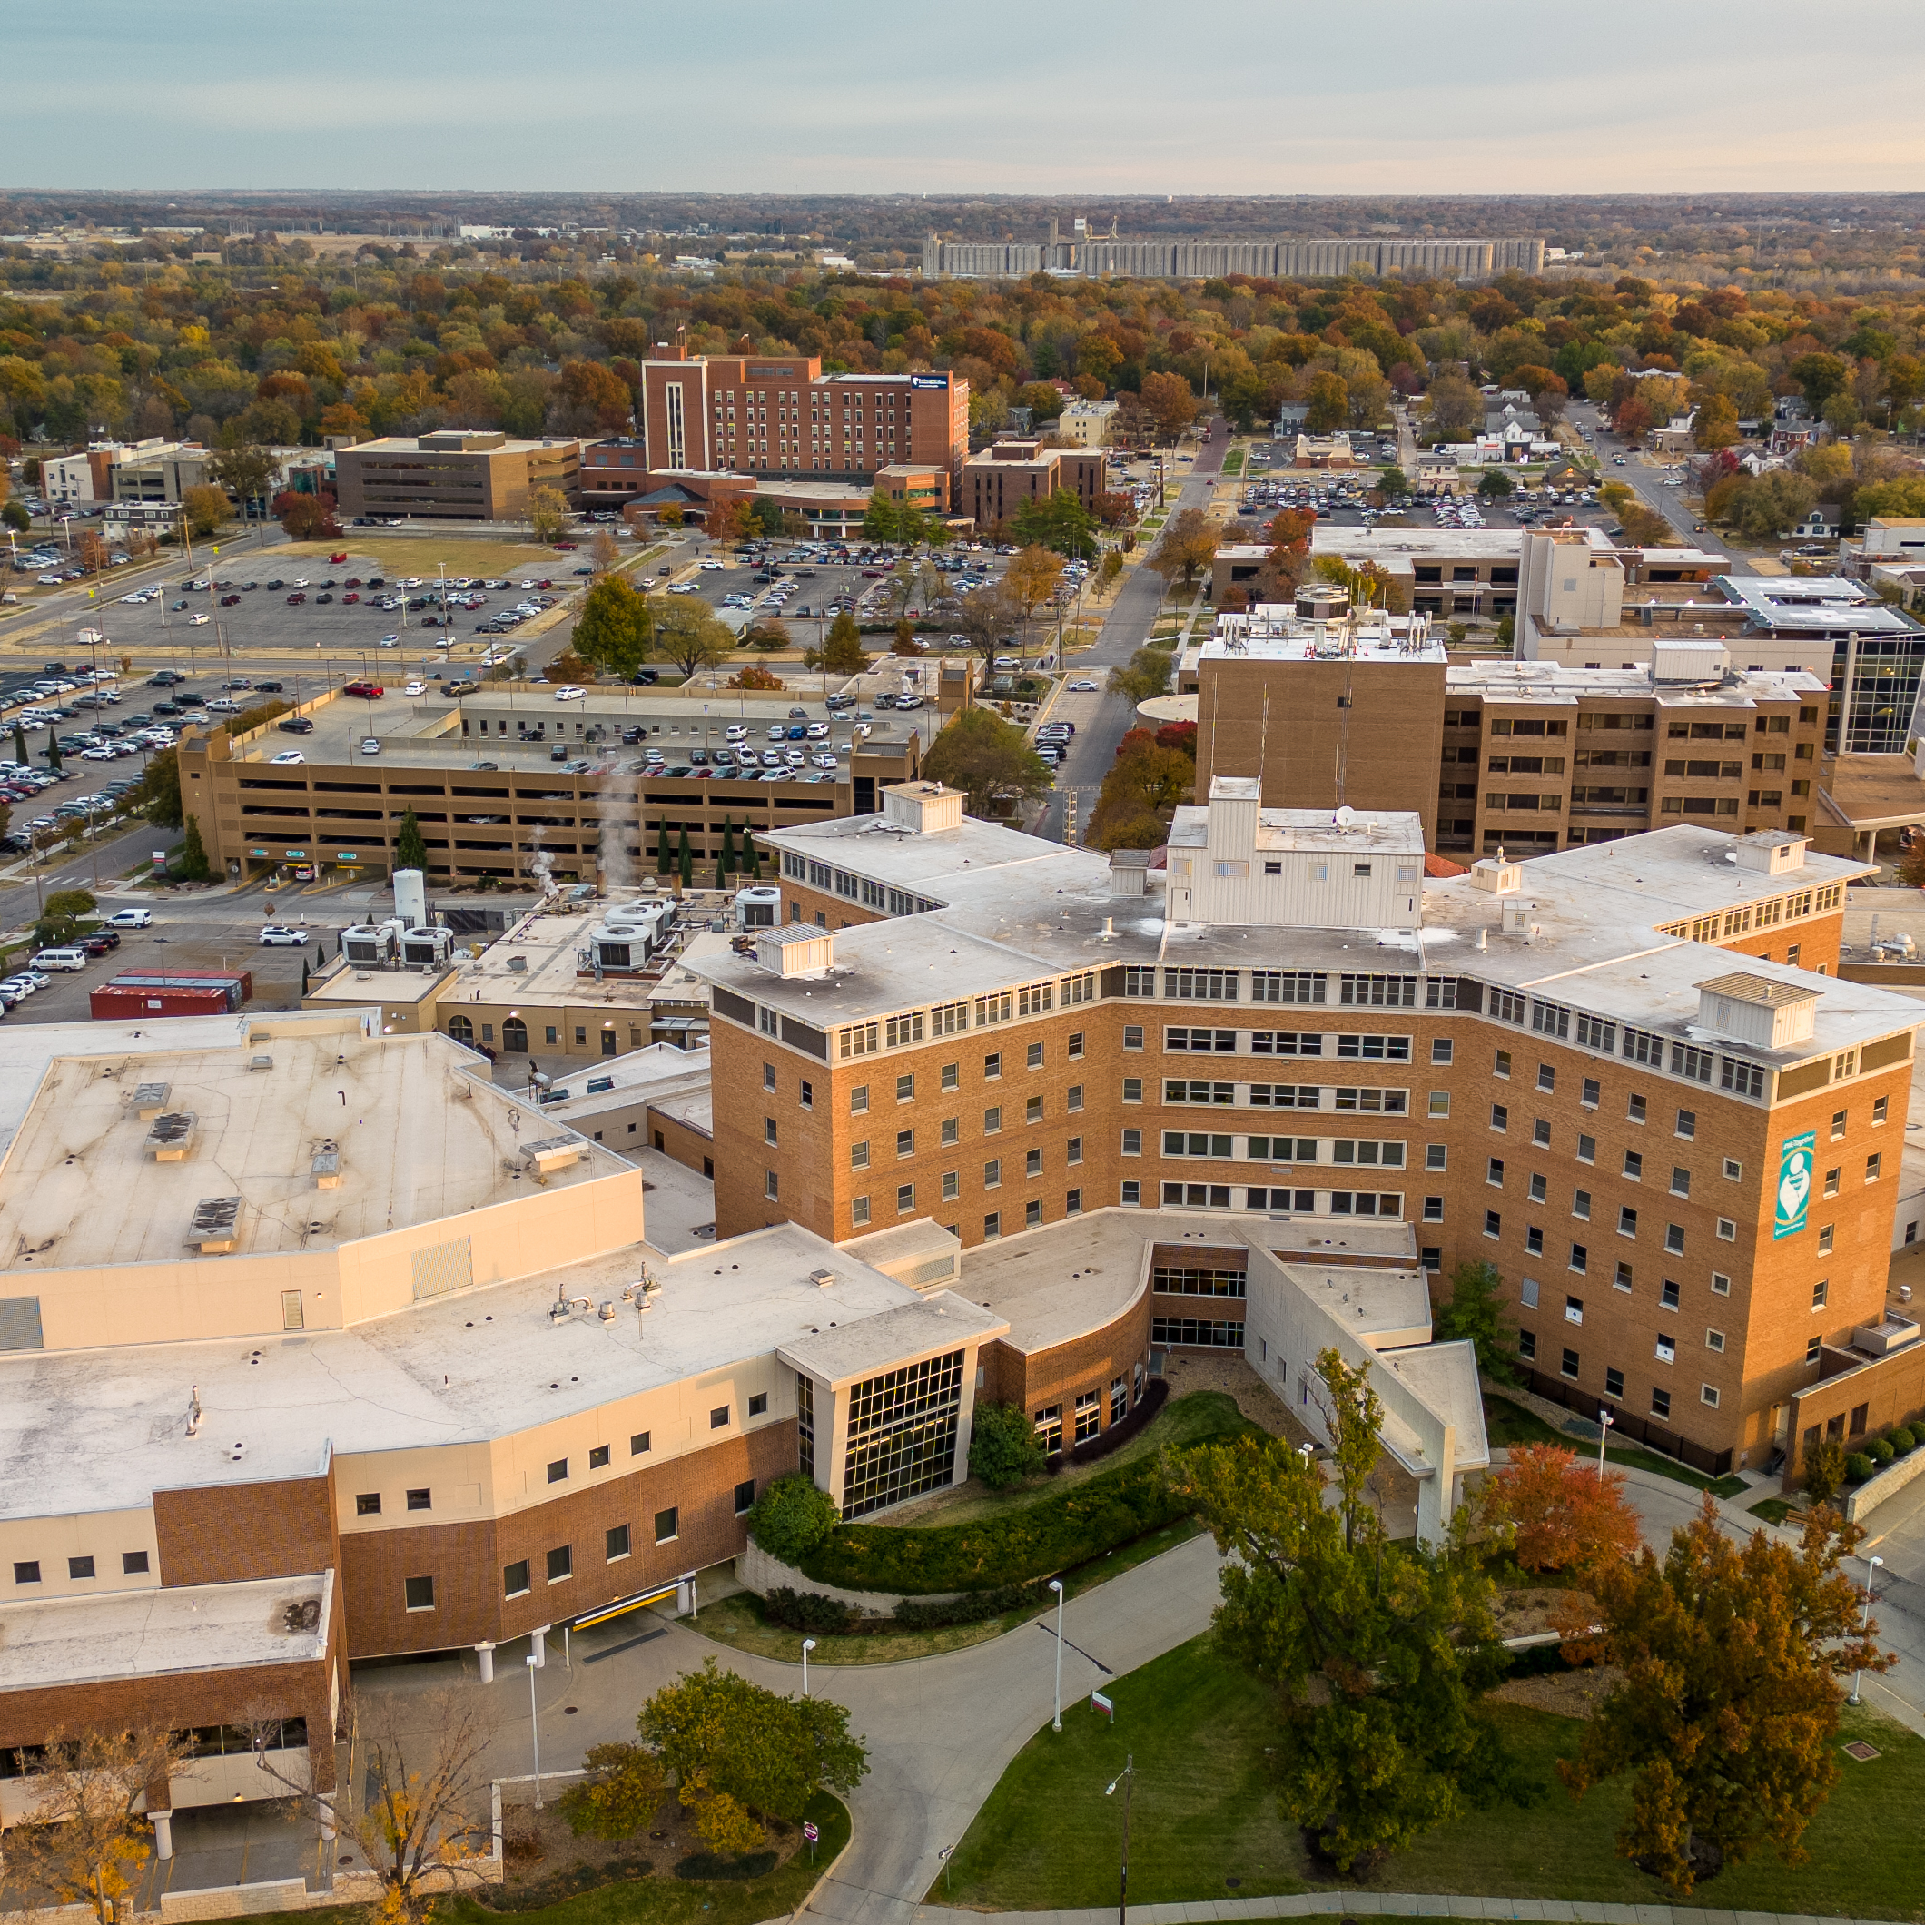
New Providers and Service Lines
Strategies and Methods to Promote
Anita Fry
Notes:
Title Slide With Picture and Small Logo

Slide 2
About Stormont Vail
15 Kansas counties in primary service area
30+ Locations – includes hospitals in Topeka and Junction City, behavioral health hospital and clinic, specialty, primary and urgent care clinics, imaging center, pharmacy, two ambulatory surgery centers
5,689 Team Members
283 Physicians
262 Advanced Practice Providers
Notes:
Title Slide With Large Logo

Slide 3
__
Stormont Vail Marketing
& Communications Team
We have 14 creative and talented team members.
Our team includes writers, designers, digital specialist, web designer, videographers/photographers, project coordinator, marketing specialist, and leadership.

Slide 4
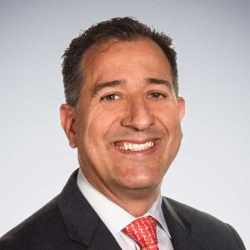
__
New Provider Package
Web Page – part of provider searchable database on stormontvail.org. For all employed physicians and advanced practice providers (APRNs and PAs)
Introductory video (physicians)
Media release
Team communication
Social media
Added to service line collateral/Rack card
Regional Relations – meet referring physicians
Dr. Dana Balderrama
Plastics & Reconstructive Surgery

Slide 5
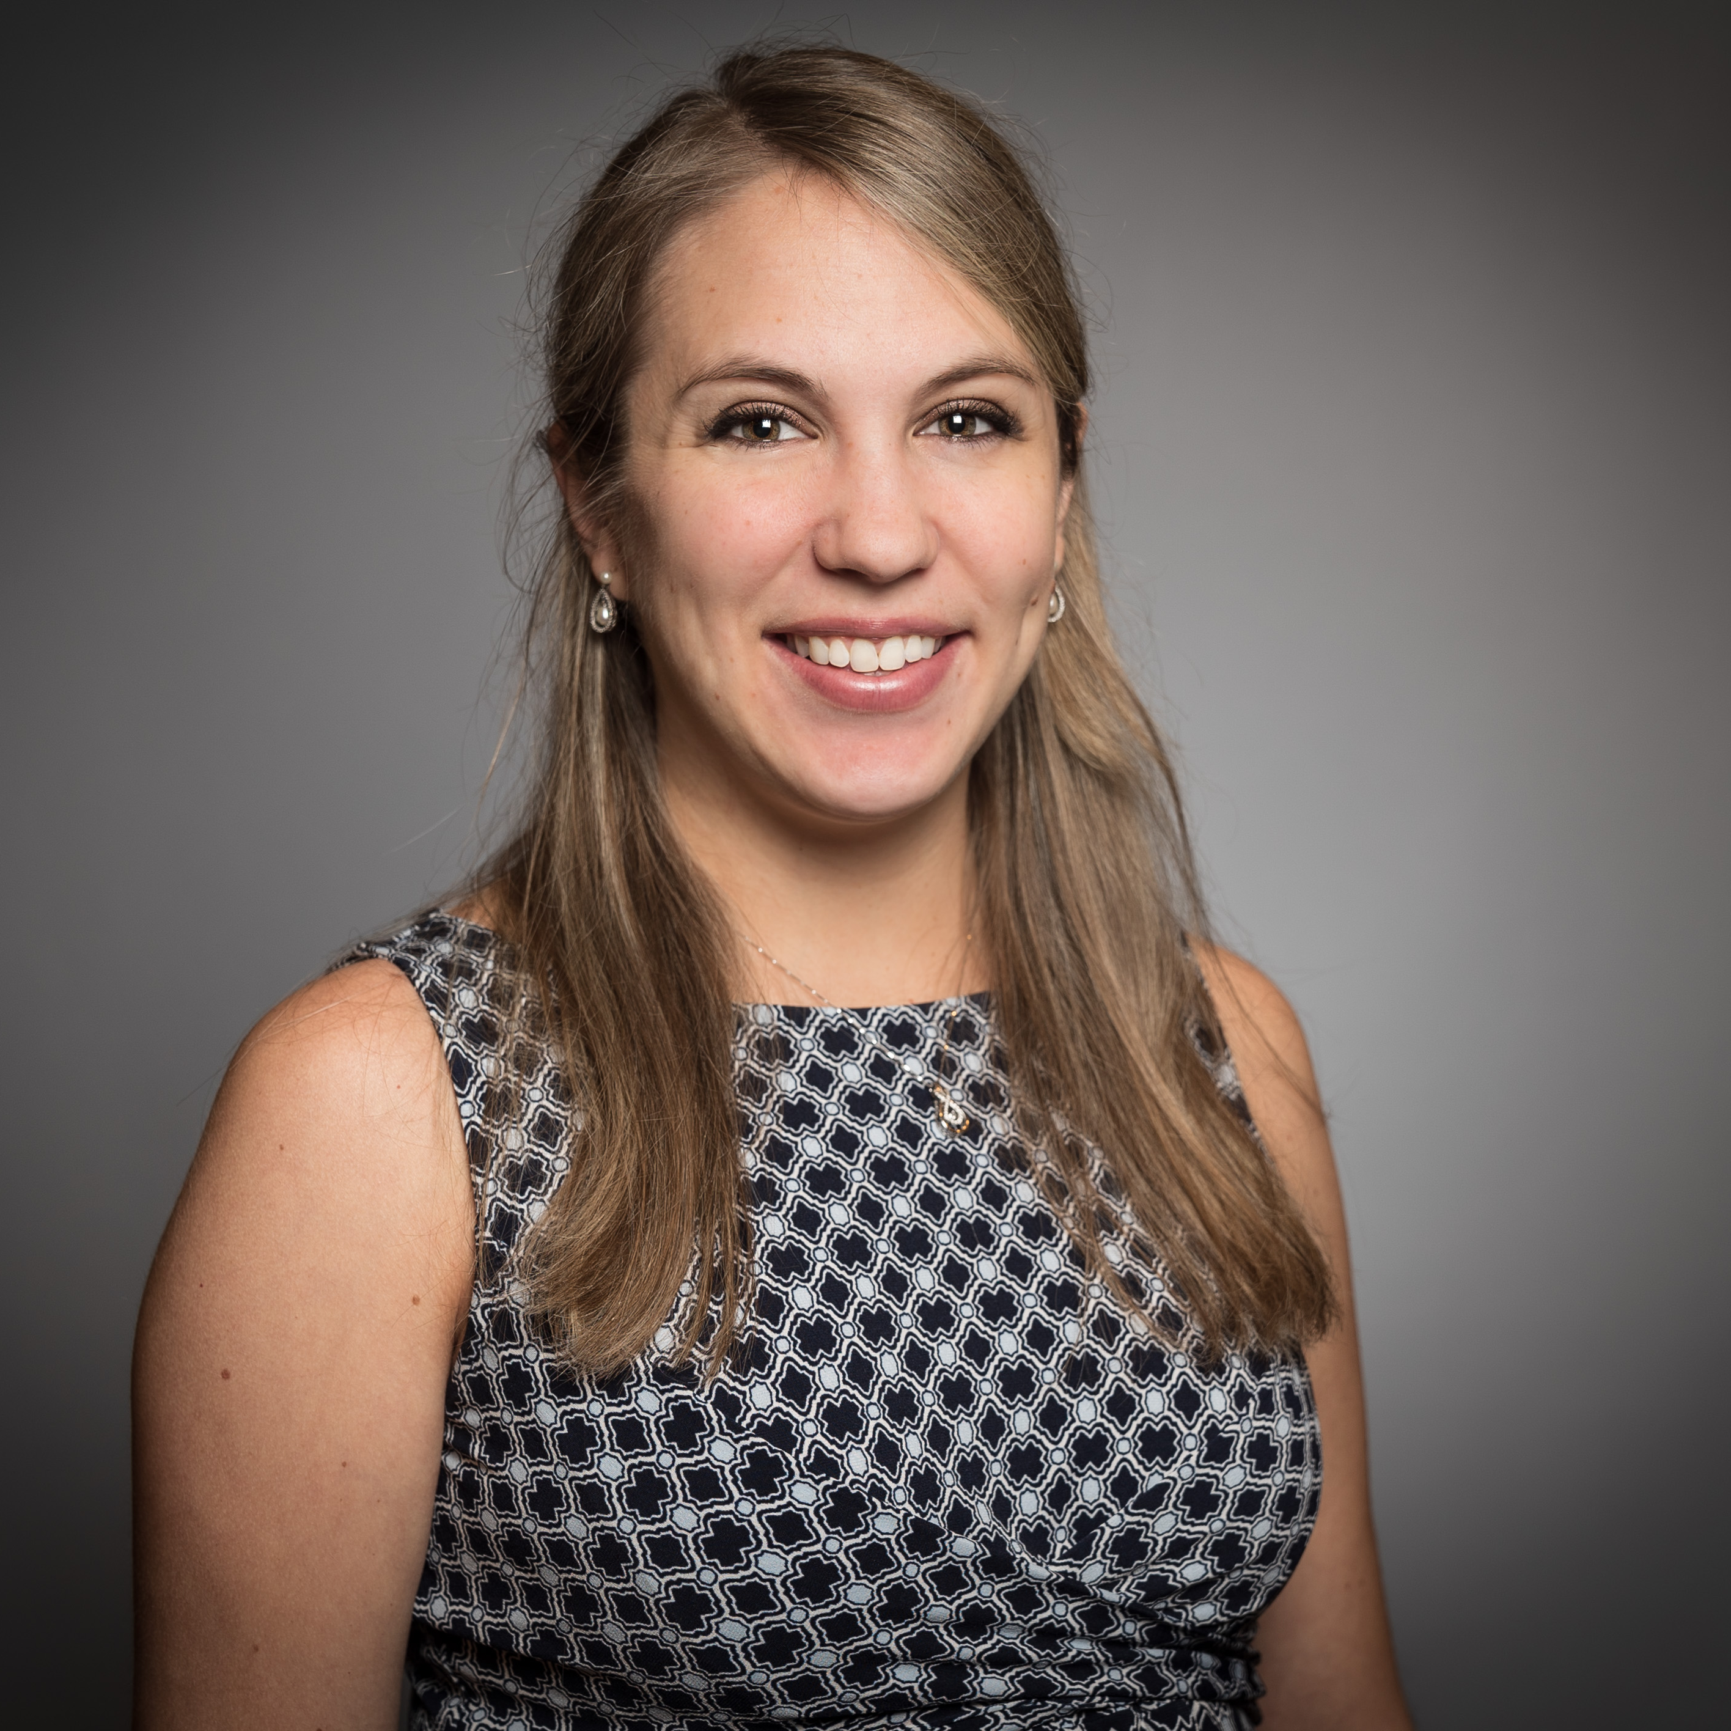
__
Service Lines
& New Services
Support overall organization Strategic Plan and areas of focus and growth
Regular meetings with major Service Lines
Discuss new providers, new or enhanced procedures or services, milestones, and impactful patient stories.
Determine audience to determine best tools: Social media, web site (internal/external), blog, media, videos, broadcast, print advertising, internal and external communications, collateral, events, rounding, health fairs, presentations.
Dr. Sara Stewart
Weight Management Clinic, Manhattan

Slide 6
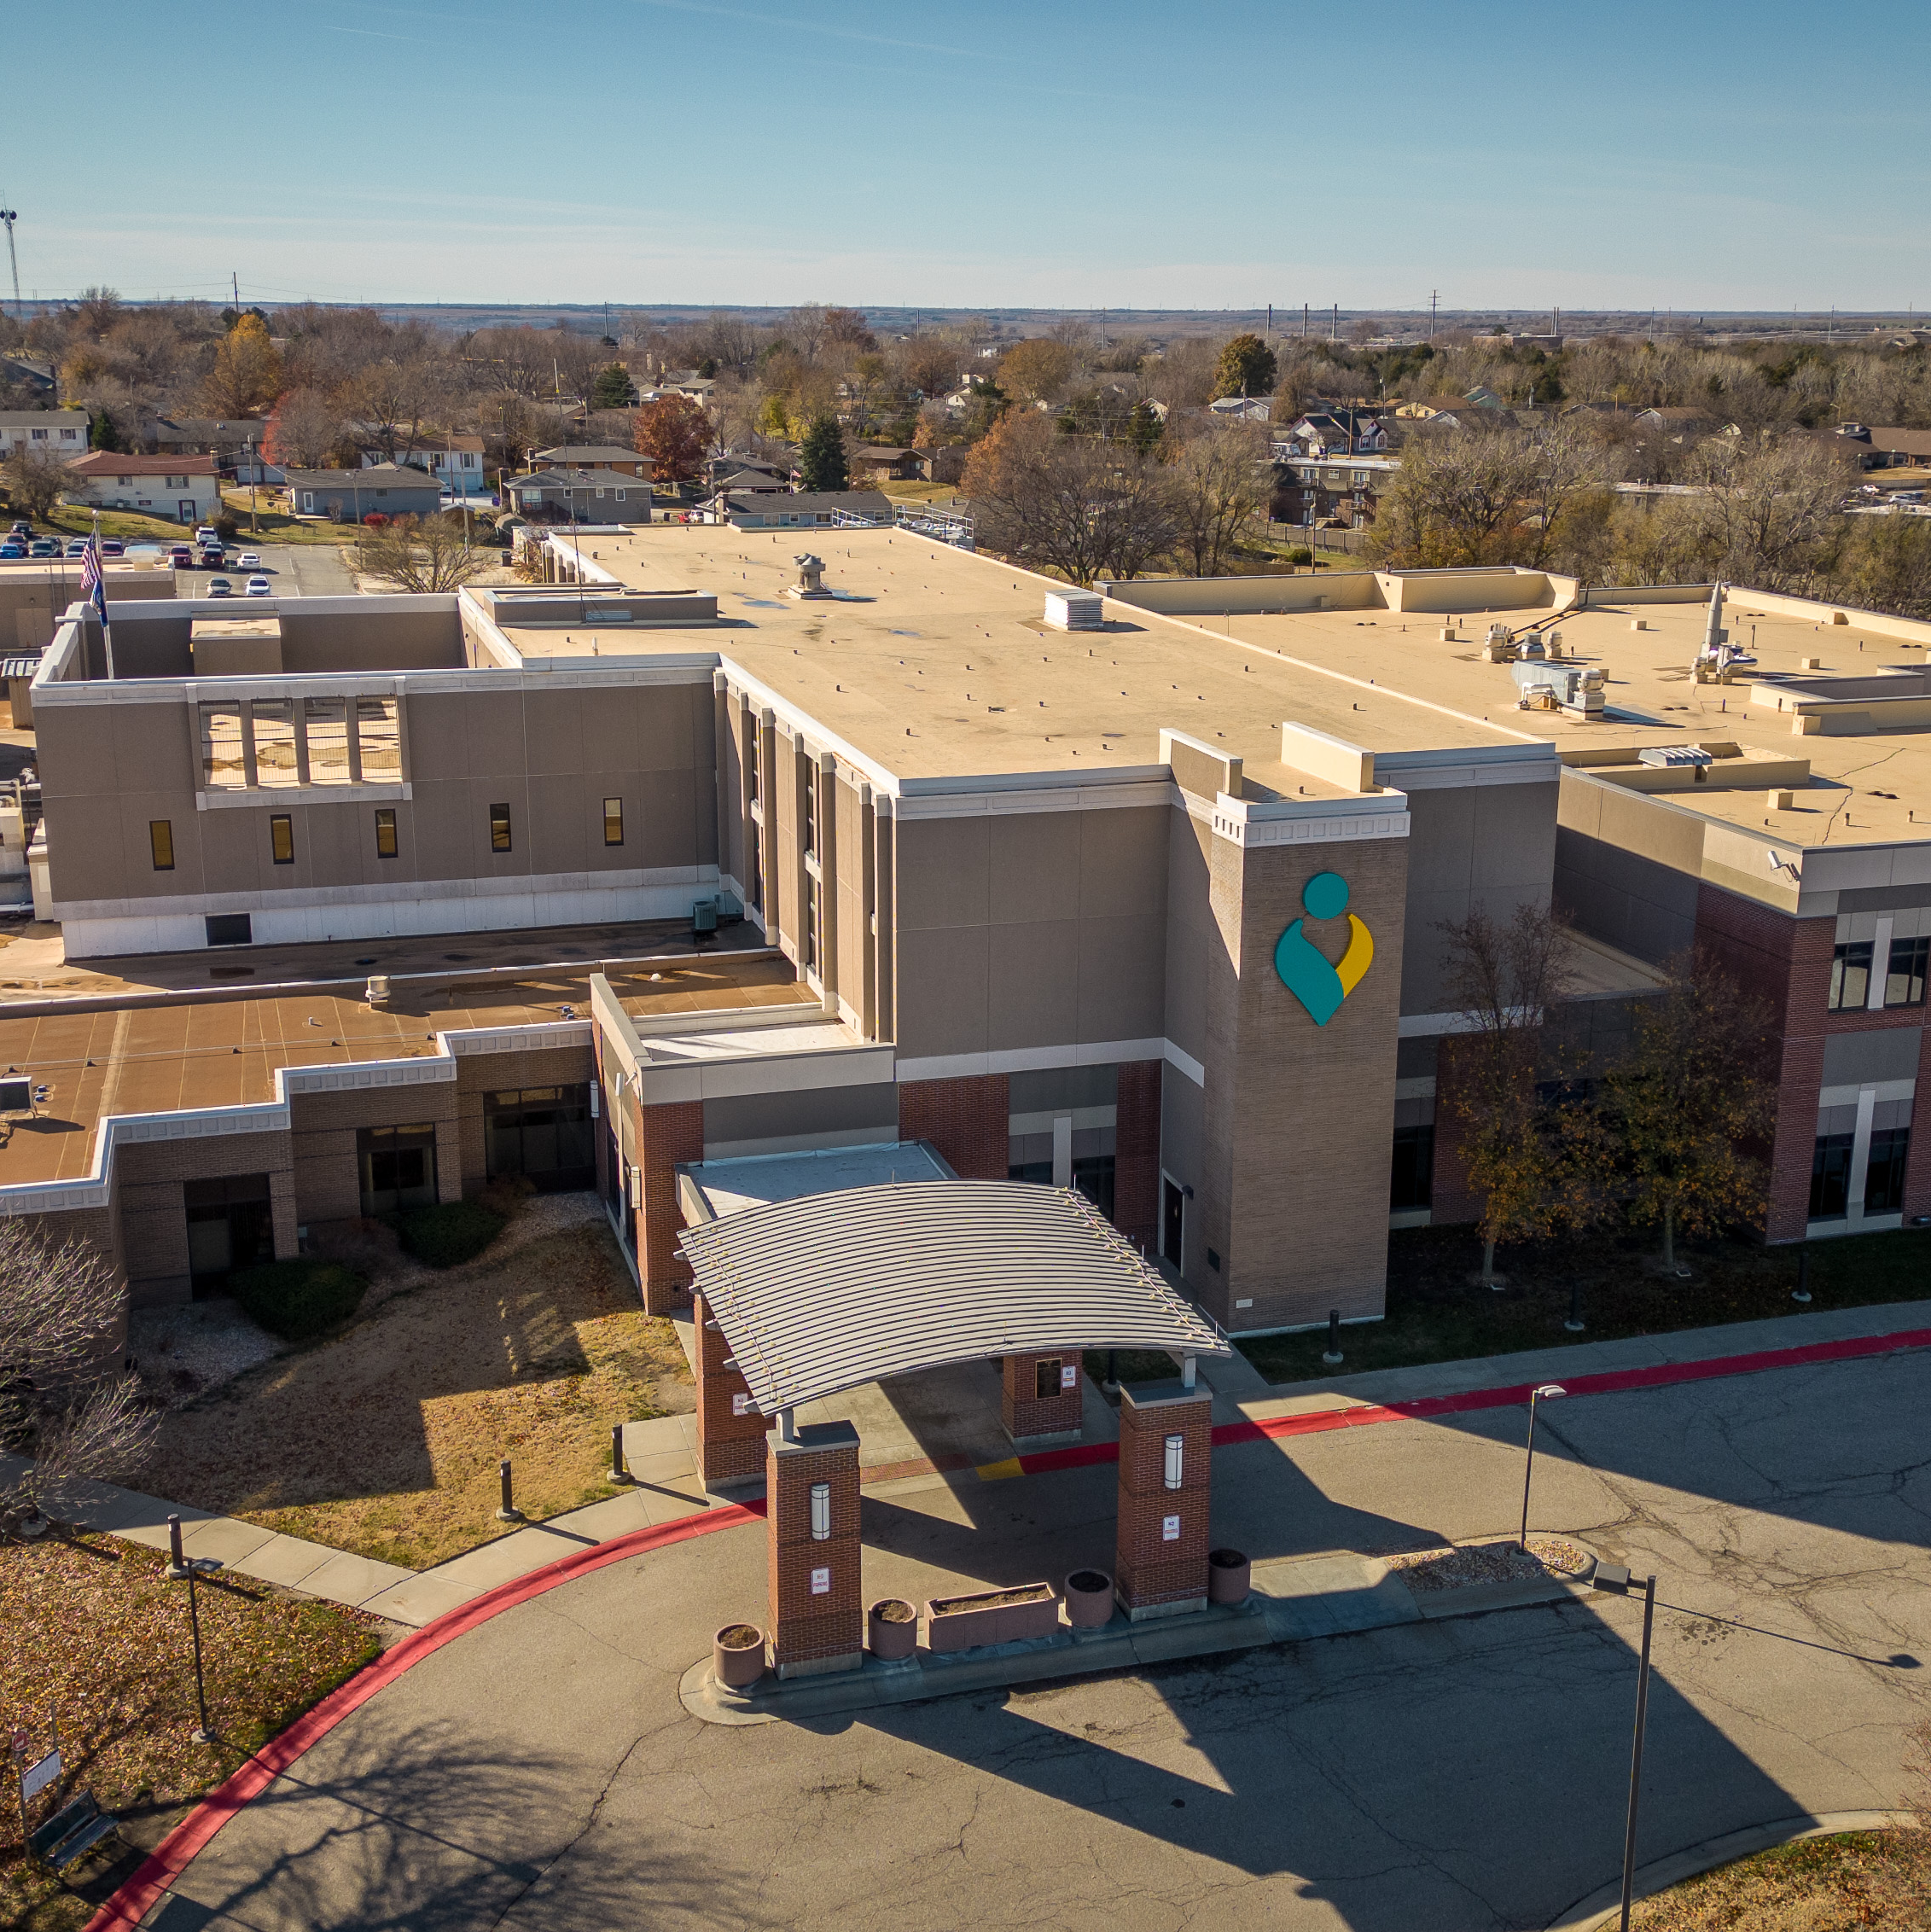
__
Flint Hills Campus
Geary Community Hospital and Rural Health Clinic joined Stormont Vail Jan. 1, 2023
Service lines – majority line up with organization service lines
Managed Geary Community 7 months before they became part of SVH; Retained team
Introduced Stormont Vail to community; developed marketing and promotional campaign for overall facility, as well as specifics for various service lines. Open house, ribbon cutting, Bulgogi Day
ED and Hospitalists programs developed

Slide 7
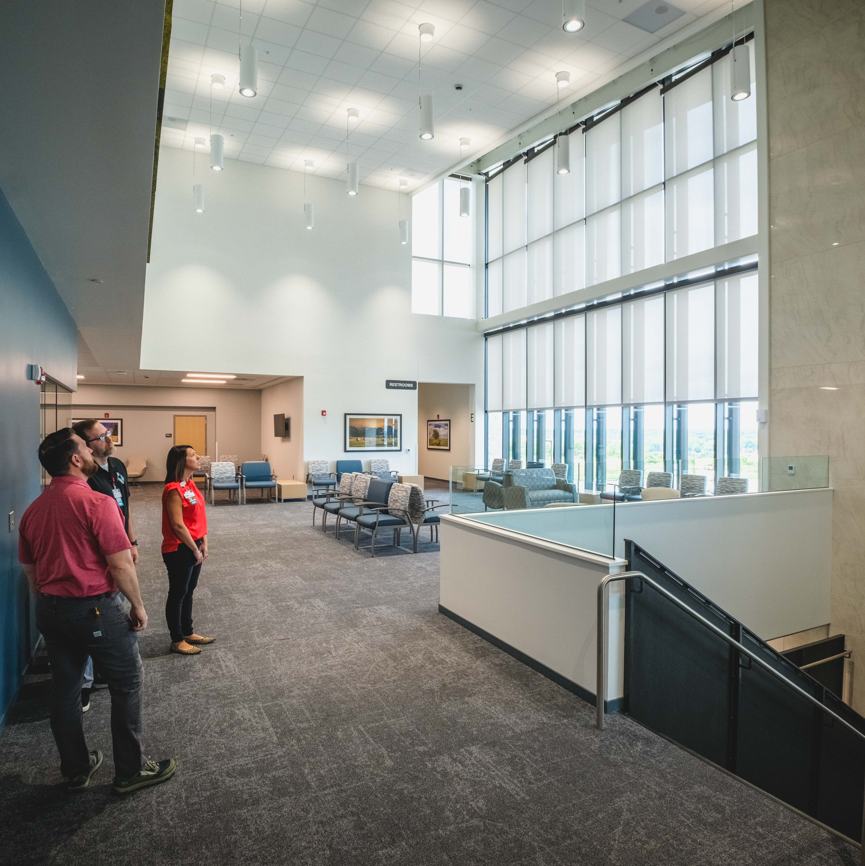
__
Manhattan Campus
Summer 2023 - Opened one location at the edge of K-State Campus: primary and specialty clinic, lab, imaging services
Previously in five different locations; moves took place over a three week period
Community awareness: Beam signing event, Groundbreaking event, Family/Media sneak peak, Ribbon cutting
Connection to Flint Hills Campus and services just a short distance away

Slide 8
__
THANK YOU
Notes:
Questions or Thank You Slide

