Slide 1

What to Say and How to Say It:
Behavioral Economics & Health Communication

Slide 2

Behavioral economics
A field of economics that integrates insights from psychology into economic theory to explain how real people make decisions.
It challenges the traditional economic assumption that individuals are rational agents who always act to maximize their utility.
Instead, behavioral economics suggests that cognitive, social, emotional, and psychological factors significantly influence decision-making processes.

Slide 3

How do our brains function?
Our brains have to process an infinite amount of stimuli and make an endless number of decisions. So to save time and mental energy, our brains rely on heuristics, or short-cuts.
Biases are systematic errors in thinking that interfere with how we reason, process information, and perceive reality.
Biases and heuristics are part of our automatic or intuitive system of thinking, so they occur without our awareness. But because they impact nearly all of our thinking and decision making, familiarity with the most common errors is a great way to become a better critical thinker.
Notes:
Think of heuristics like guidelines, or rules of thumb: they’re usually good enough most of the time, but they can result in errors.

Slide 4

Motivated Belief

Slide 5
Motivated Belief
Belief often fulfils important psychological and functional needs of the individual: confidence in one’s ability, hope, social identity, political ideology, and religion faith (Bénabou et Tirole, 2016).
Using Data from the Survey of Consumer Finances, Puri and Robinson (2007) find that more optimistic individuals work more, save more, expect to retire later, and are more likely to re-marry after divorce.
Beliefs about determinants of economic success (luck or effort) are strong explanatory factors of individual attitudes toward redistribution as well as actual as well as actual national social spending (Alesina et al. 2001).

Slide 6
Motivated Belief
Wiswall and Zafar (2015) elicit college students’ beliefs about their own future earnings and the average earnings in different majors. Then they provide the actual figures for each major and elicit subjects’ updated beliefs about their expected incomes.
College students are substantially misinformed about population earnings and revise their earnings belief in a sensible way in response to the information.
The effect of information is asymmetric: There is significant updating when the information is good news for the respondent: an underestimation of population earnings by $1000 results in an upward revision in own earnings of $347 (p<0.01), compared with a downward revision of just $159 for an overestimation (p<0.1).

Slide 7
Motivated Belief
Eil and Rao (2011) used IQ test, and physical attractiveness (Beauty), as rated by subjects of the opposite sex.
For good news, the inference was less noisy, respected signal strength and conformed much more closely to Bayesian rationality.
Conversely for bad news, beliefs were more noisy and signal strength was not respected, which led to discounting bad news on net.

Slide 8

Projection Bias

Slide 9


Projection Bias
Projection bias refers to the tendency of the individuals to over-predict the degree to which one’s future tastes will resemble one’s current tastes.
“Never shop on an empty stomach.”

Slide 10

Hyperbolic discounting

Slide 11
Intertemporal Choice
People make decisions about what and how much to do at various points in time, when choices at one time influence the possibilities available at other points in time.

Slide 12
Hyperbolic discounting
A class of economists argue that individuals are often affected by what is called the temporal myopia.
The consumer's typical response to uncertainty in this case is to sharply reduce the importance of the future of their decision making. In the common tongue it reflects the sentiment “Eat, drink and be merry, for tomorrow we may die.”

Slide 13

Intrinsic vs. Extrinsic Motivation

Slide 14
Intrinsic vs. Extrinsic Motivation
When explicit incentives seek to change behavior in areas like education, contributions to public goods, and forming habits, a potential conflict arises between the direct extrinsic effect of the incentives and how these incentives can crowd out intrinsic motivations in the short run and the long run.

Slide 15
Intrinsic vs. Extrinsic Motivation
Monetary incentives from principals may change how tasks are perceived by agents, with negative effects on behavior.
Eg. an incentive for a child to learn to read might achieve that goal in the short term, but then be counterproductive as an incentive for students to enjoy reading and seek it out over their lifetimes.
Uri Gneezy

Slide 16

Communication

Slide 17

Functions of Communication
Instrumental functions of communication
Information transmission
Strategic communication
Non-instrumental function of communication
Emotion expression

Slide 18
AI and Communication
In recent years, the implementation of AI in communication-intensive industries, such as professional services, healthcare, and education, has surpassed its use in manufacturing
(Acemoglu et al. 2022)
One body of literature suggests that AI cannot completely replace the roles of humans, particularly in aspects such as trust, cooperation, and emotional responses
- Less trust (Dietvorst et al. 2015; Schniter et al. 2020), lower willingness to cooperate (Maggioni and Rossignoli 2023), less emotional expression (Chugunova and Sele 2022) towards AI
Another line of research in the field demonstrates the efficiency of AI
- Working performance (Luo et al. 2019; Bao and Huang 2022; Ayers et al. 2023); consumer satisfaction (Mende et al. 2019)

Slide 19
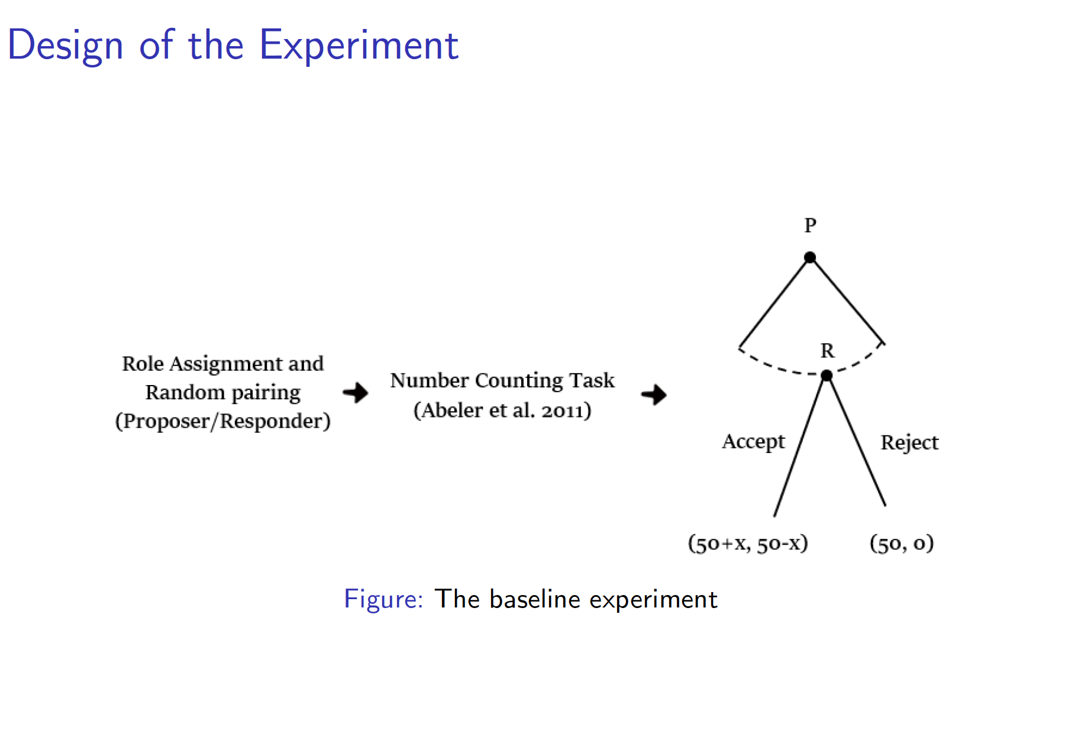

Slide 20
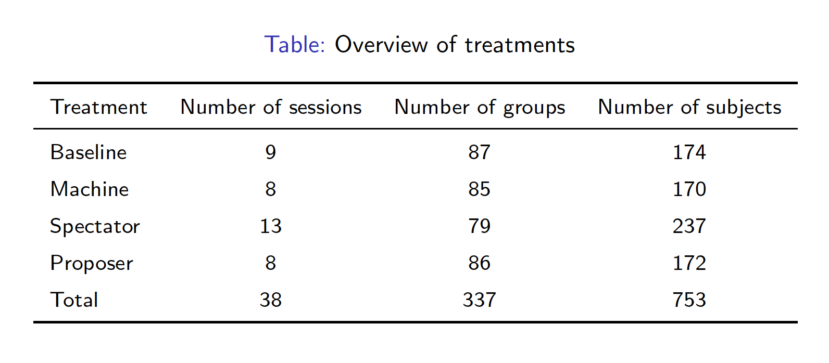

Slide 21
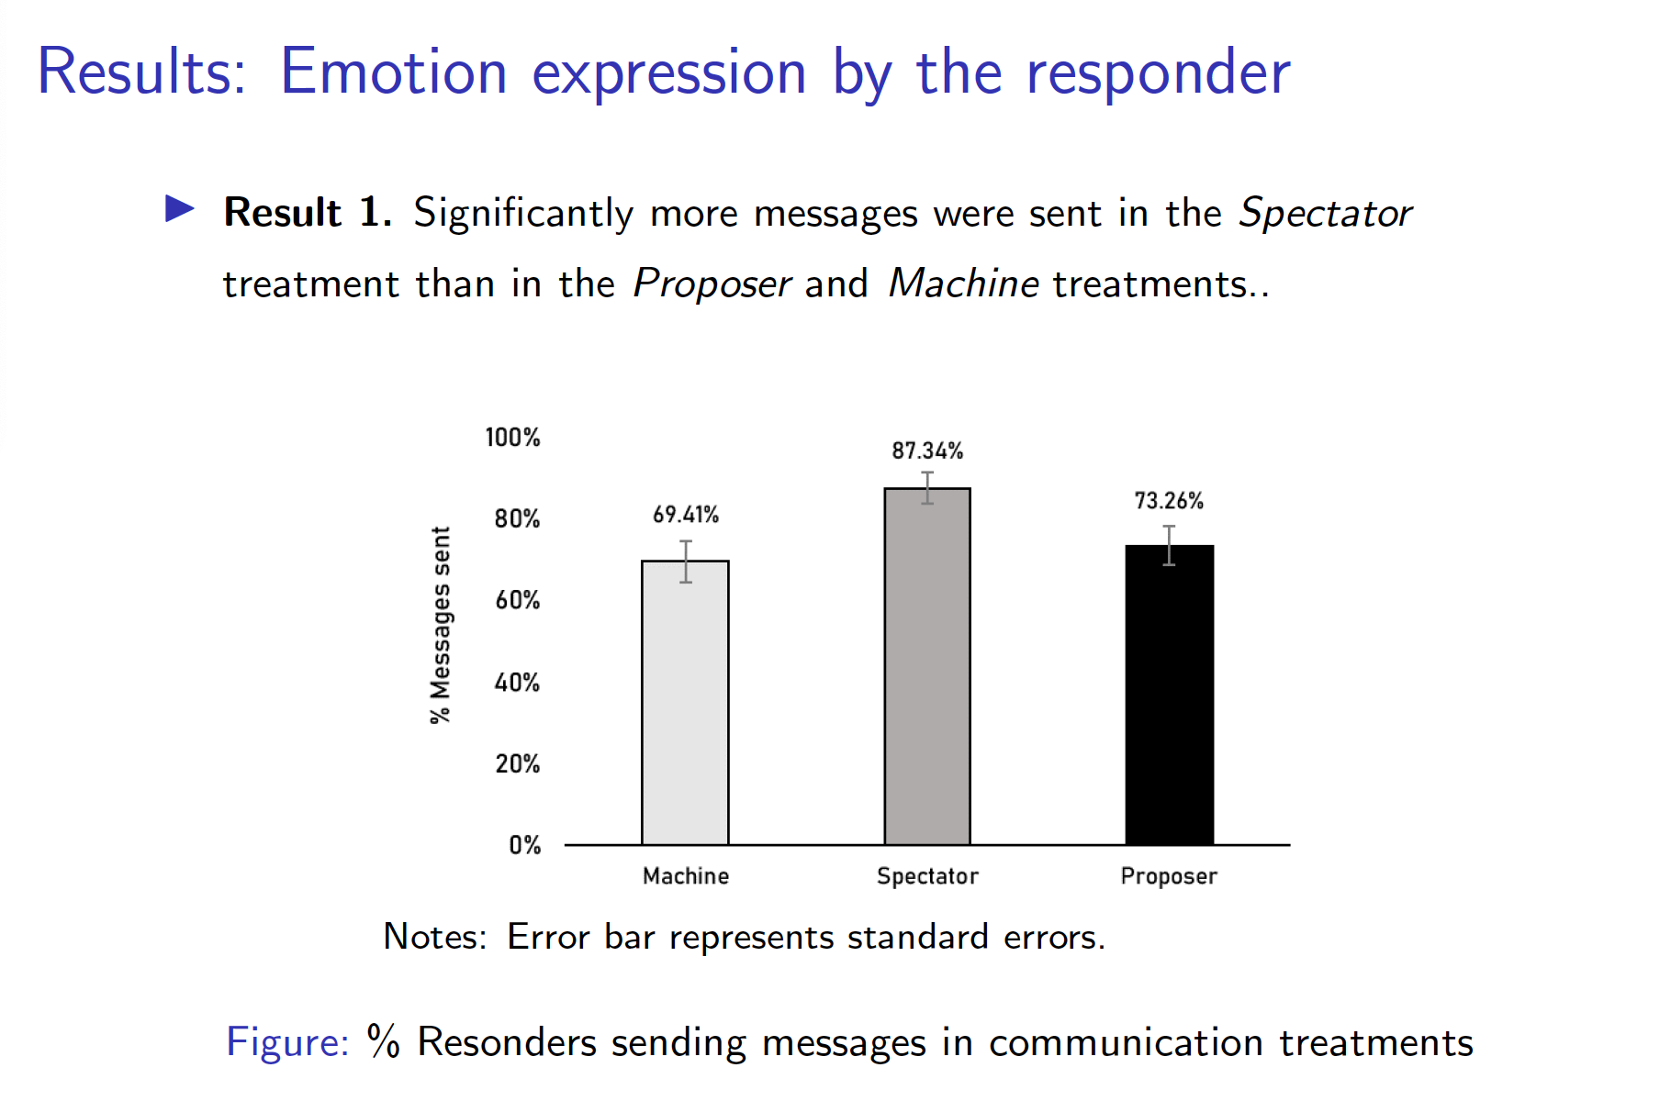

Slide 22
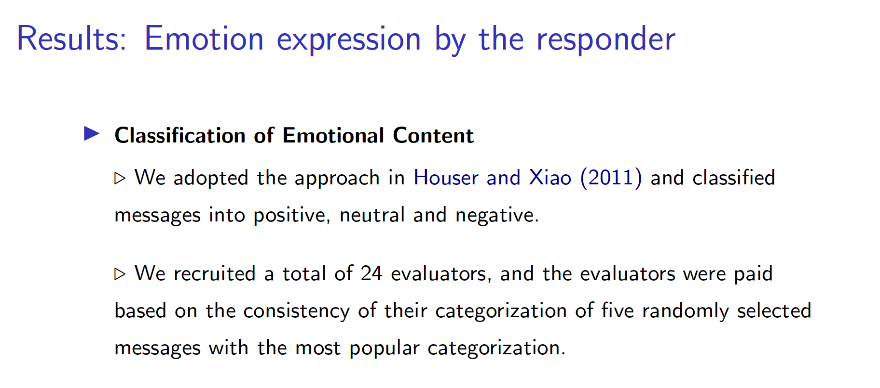

Slide 23
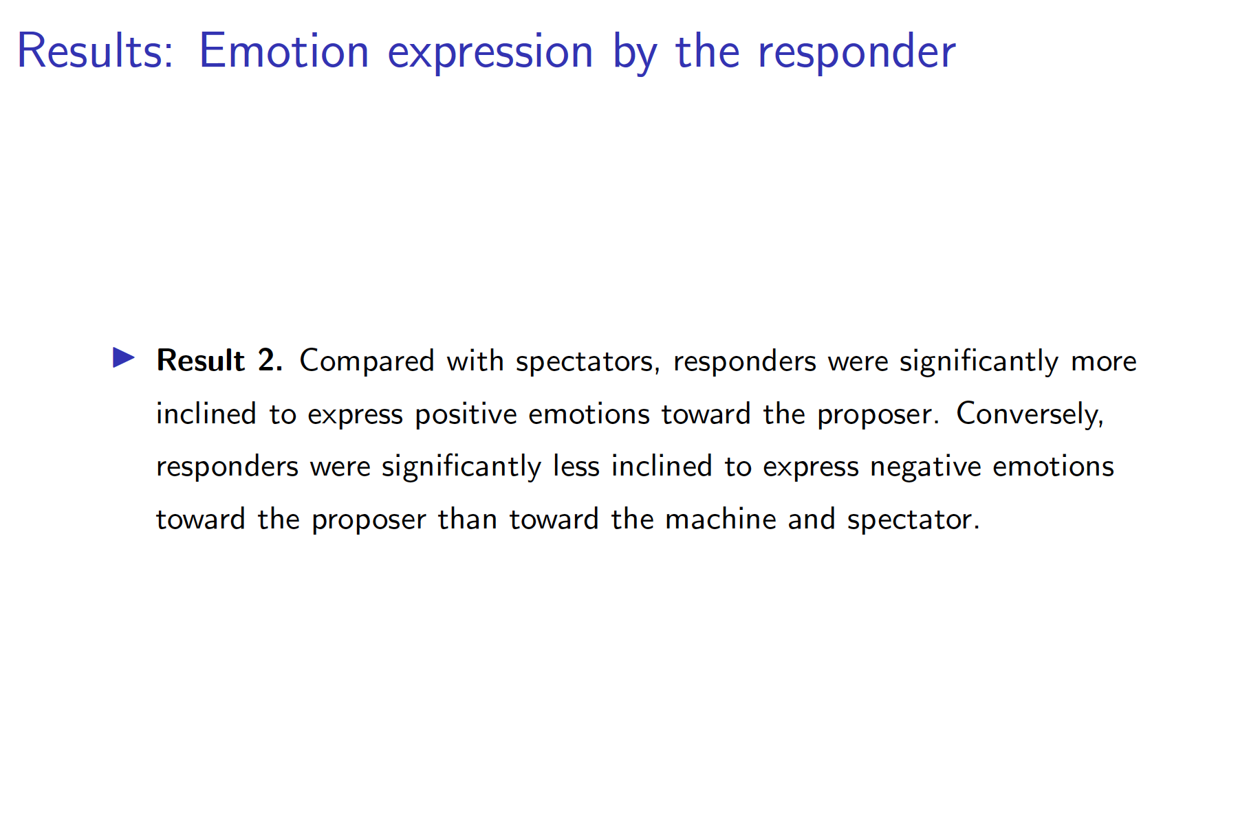

Slide 24
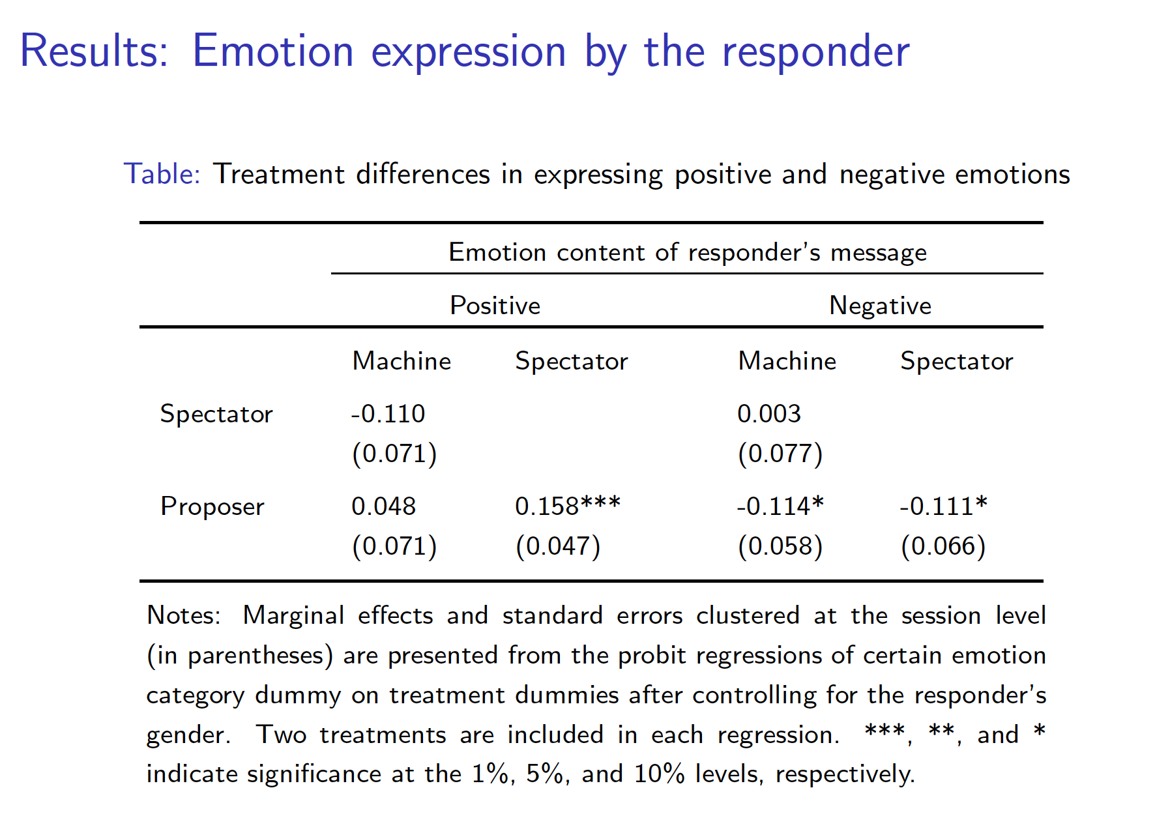

Slide 25
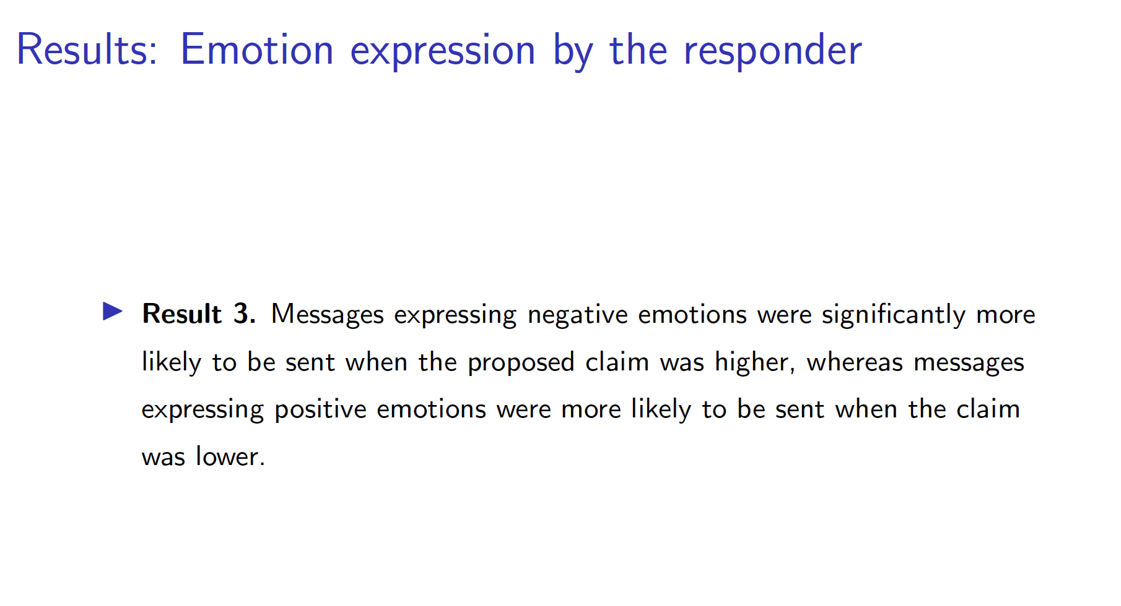

Slide 26
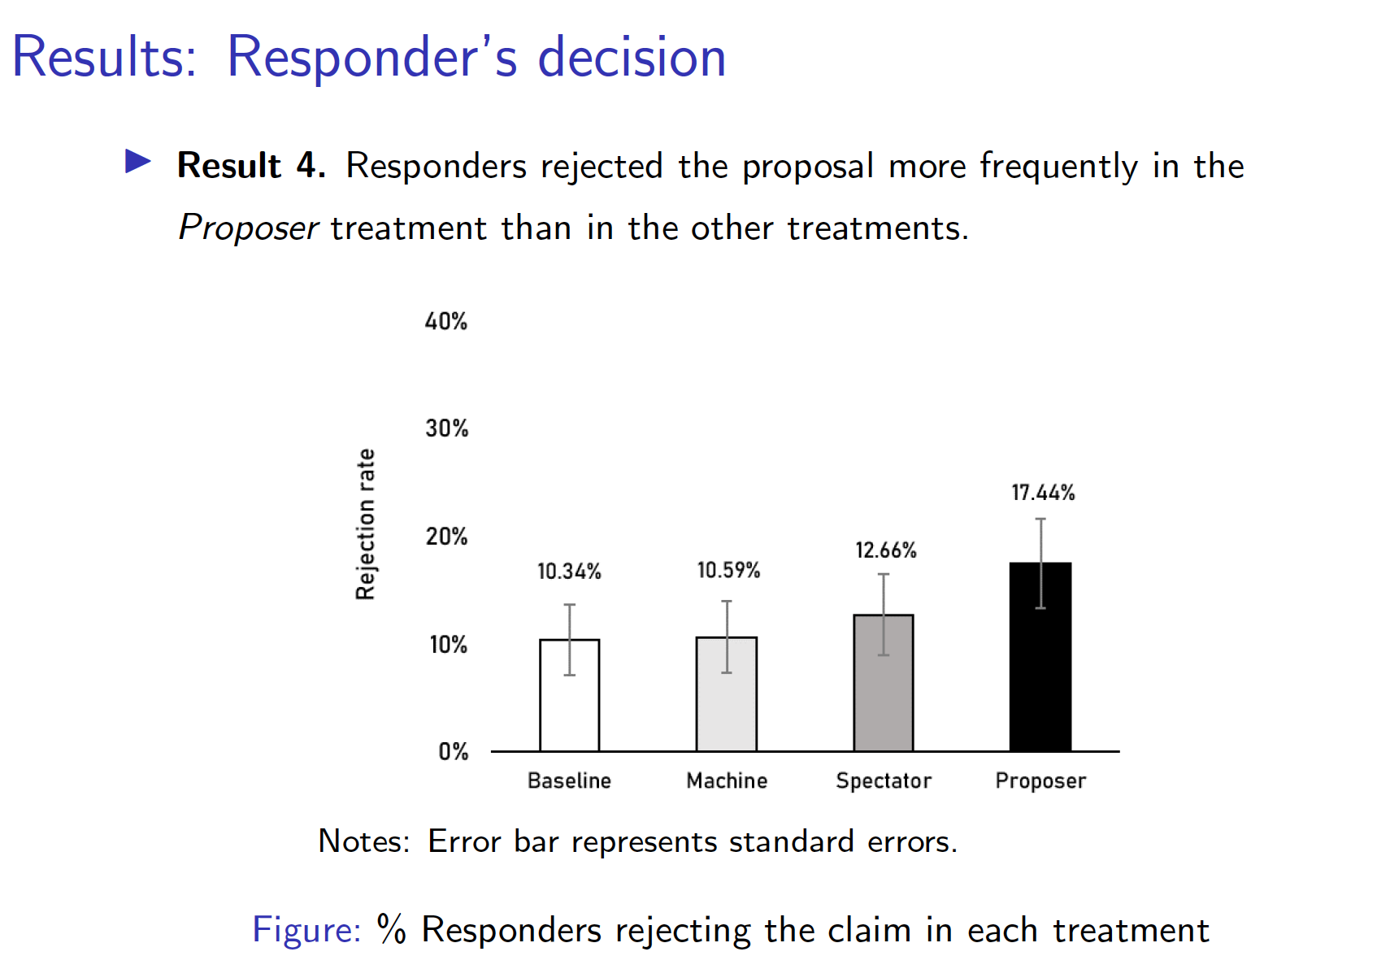

Slide 27
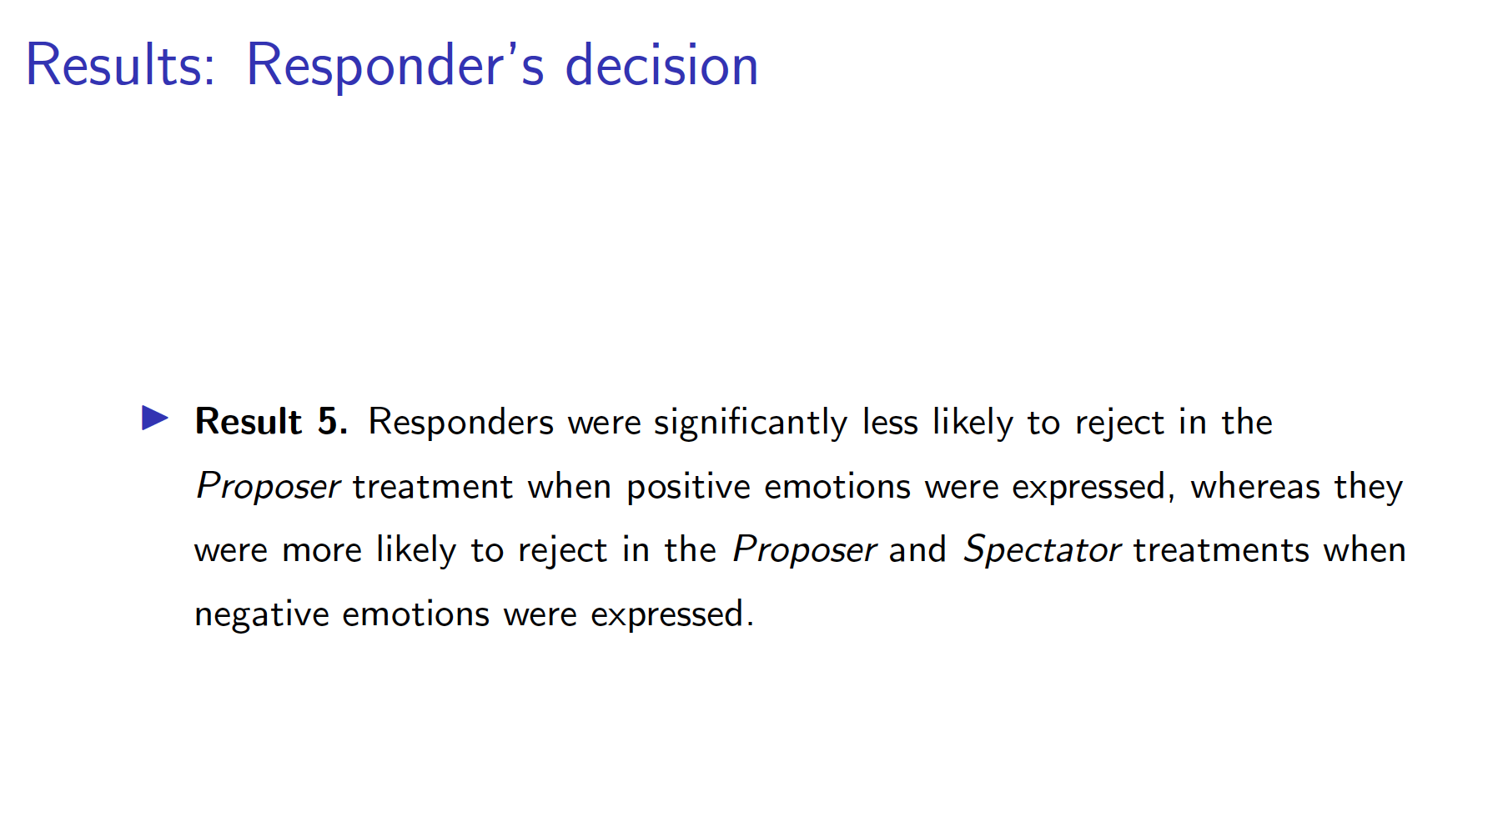

Slide 28
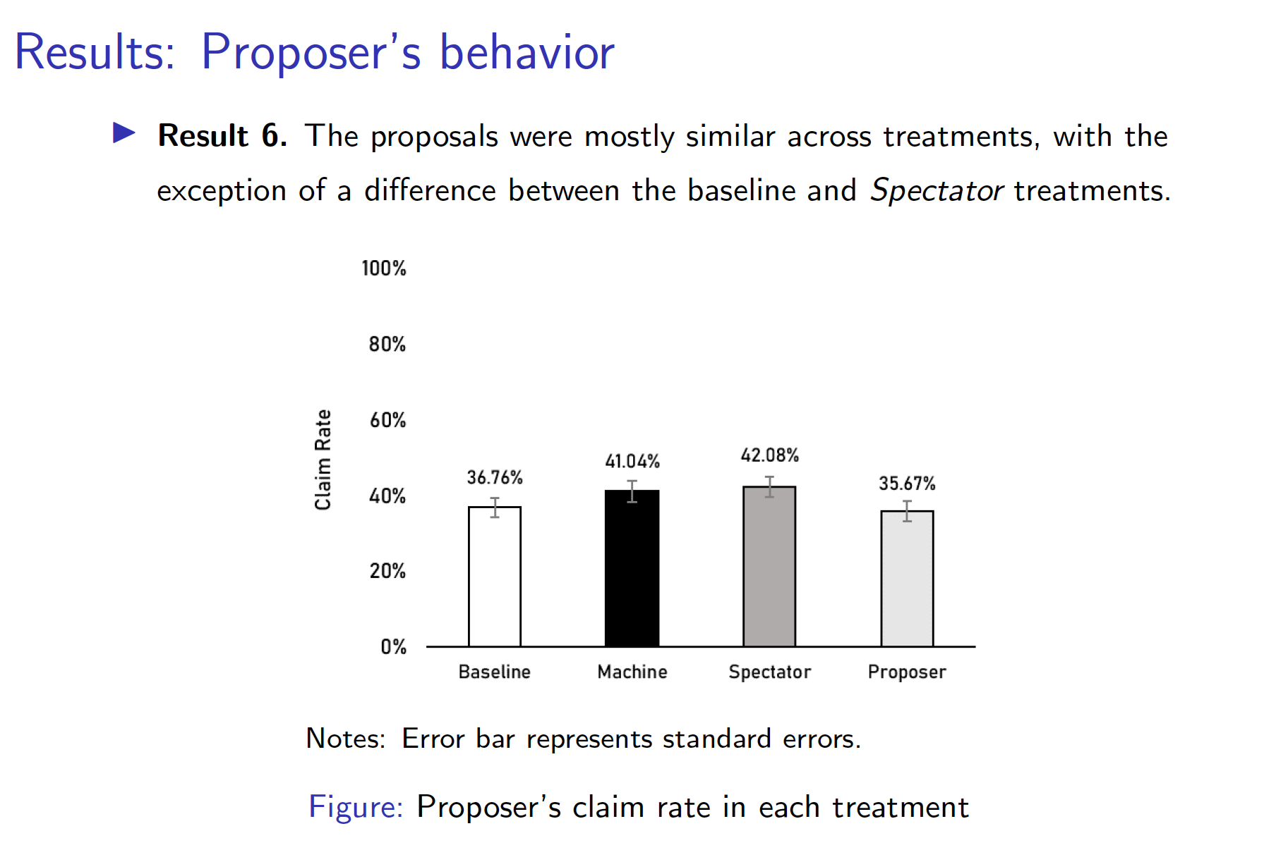

Slide 29
Take aways
People exhibit both rational and irrational behaviors
Understanding individual cognitive, social, emotional, and psychological factors is crucial for effective communication
Listening is more important than speaking
The function of listening cannot be replaced by AI
More well-controlled studies in health care communication field need to be conducted (email me at Siyu.Wang@Wichita.edu)

