Slide 1


Slide 2

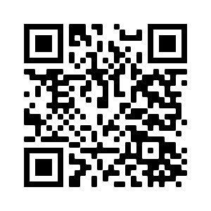
The campaign encourages hospital employees to vote in the 2024 election to show elected officials and candidates that we care–for our patients, our communities, and our local and state economies.
Customizable advocacy toolkit online: www.kha-net.org/advocacy/wecarewevote
Get out the Vote Campaign
We CARE We VOTE

Slide 3
Kansas hospitals employ approximately 100,000 people.
Hospital employees are in a powerful position to make a difference—both with their votes, and with their voices as advocates for better health.
Get out the Vote Campaign
We CARE We VOTE

Slide 4
Kansas Primary Election
August 6, 2024
Get Ready
Register by July 16, 2024
-Register by mail, fill out the form and send to your county election officer
-Register online at kdor.ks.gov/apps/VoterReg
-Not Sure? Check your registration at myvoteinfo.voteks.org
Get Set
Party Affiliation
-Do I have to declare a party affiliation?
Yes, for the partisan primary. Although you do not have to be registered with any party to vote in the special election or local non-partisan elections..
ID
State law requires voters to show ID when casting a vote including advance in-person. If you do not have ID the voter can be issues a provisional ballot.
VOTE
By Mail
-Request advance ballot from local election officer by July 30.
-Fill it out and mail it or drop it off to your county election office.
-Ballot mailed must be postmarked by Aug. 6 and received by Aug. 9.
In Person-Advance
-Last day to advance vote in person is Aug.5.
In-Person on Election Day
-Find your polling place by visiting myvoteinfo.voteks.org.

Slide 5
Kansas General Election
November 5, 2024
Get Ready
Register by Oct. 15, 2024
-Register by mail, fill out the form and send to your county election officer
-Register online at kdor.ks.gov/apps/VoterReg
-Not Sure? Check your registration at myvoteinfo.voteks.org
Get Set
Party Affiliation Requirements
-Do I have to declare a party affiliation?
No, general elections don’t require any party affiliation to participate.
ID
State law requires voters to show ID when casting a vote including advance in-person. If you do not have ID the voter can be issues a provisional ballot.
VOTE
By Mail
-Request advance ballot from local election officer by Oct. 29.
-Fill it out and mail it or drop it off to your county election office.
-Ballot mailed must be postmarked by Nov. 5 and received by Nov. 8.
In Person-Advance
-Last day to advance vote in person is Nov. 4.
In-Person on Election Day
-Find your polling place by visiting myvoteinfo.voteks.org.

Slide 6
Get out the Vote Campaign
We CARE We VOTE
To Register
Kdor.ks.gov/apps/VoterReg
To check your Registration
Myvoteinfo.voteks.org
Find my local county election officer
All Kansas Voter Information
www.sos.ks.gov/elections/county_election_officers.aspx
sos.ks.gov/elections/elections.html
View a sample ballot before I head to the polls
Myvoteinfo.voteks.org

Slide 7
Get out the Vote Campaign
We CARE We VOTE
Frequently Asked Questions:
Q. Do I have to live in KS a certain amount of time to vote?
No, there is not a length of residence requirement.
Q. Can I pre-register if I will be 18 before the next election?
Yes, if you are 17 and will be 18 before the next election you may register to vote.
Q. I moved recently, can I still vote?
Yes, Individuals who move to a new address within the same county should update their information as soon as possible with their local election officer. If you move after the registration deadline, you may vote at the precinct assigned to your old address, but you will be required to complete a new voter registration application.

Slide 8

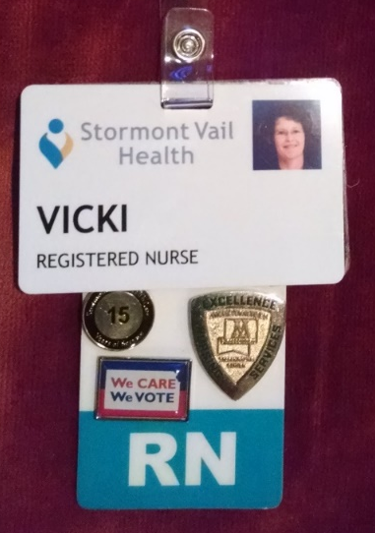
Pins for staff to show support for:
Protecting access to health care
Investing in communities and hospitals
Strengthening local and state economies

Slide 9
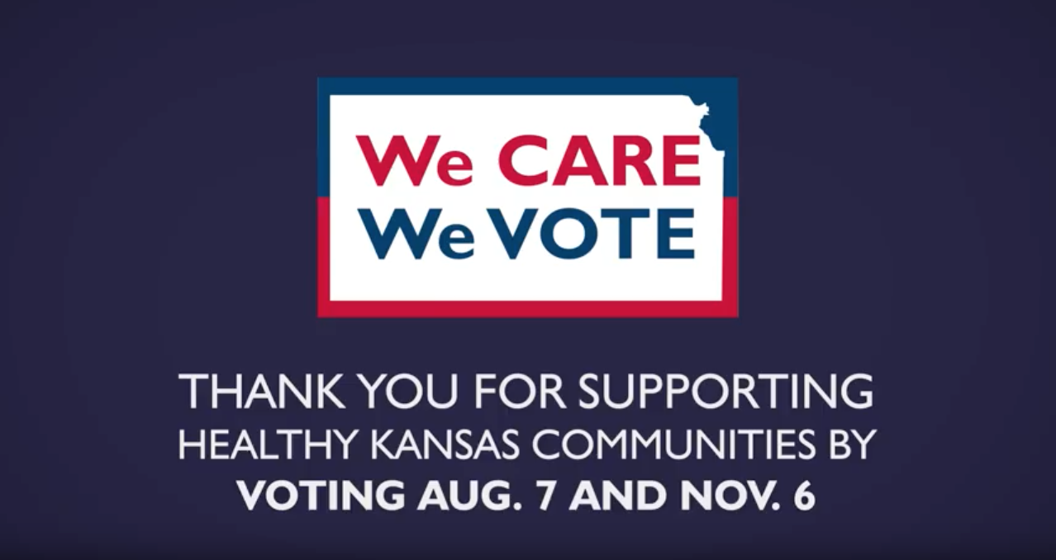
The Power of One Video
We CARE We VOTE
VOTING IN 2024
Notes:
https://app.box.com/s/srzjxc8rly953sm62cchmm8u0zfoiyef
OR
https://youtu.be/noua9YZm-BE?si=GkVCiHrAJzQJgjFn

Slide 10

THANK YOU for supporting
Healthy Kansas Communities and Voting on Aug. 6 and Nov. 5

